Slide 1
JUICE Rad. Modelling WS 2012 - SPENVIS
H. D. R. Evans
Univ. Aberystwyth
28/11/2012

Slide 2
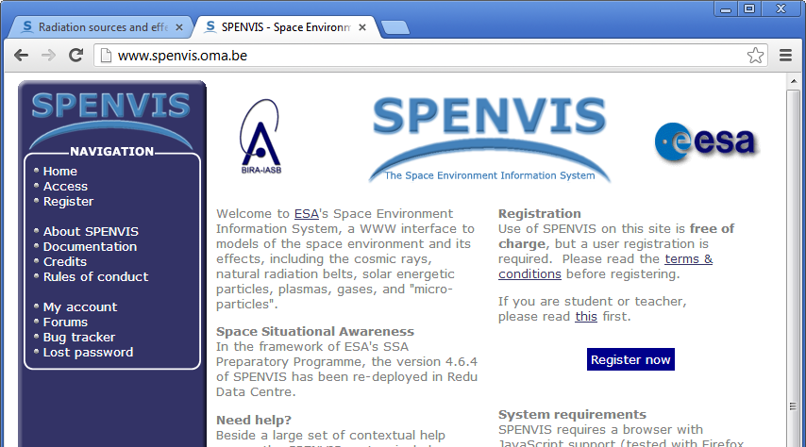
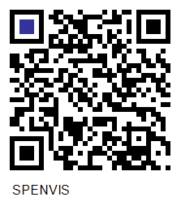
Getting on line
http://www.spenvis.oma.be/

Slide 3
Outline
Introduction to SPENVIS – getting started
Generate a mission trajectory
Overview of available radiation environment models
Use of JOREM models to calculate environment
The various simple effects tools
The Geant4 tools (Mulassis, SSAT, GRAS, GEMAT)
Exporting results

Slide 4
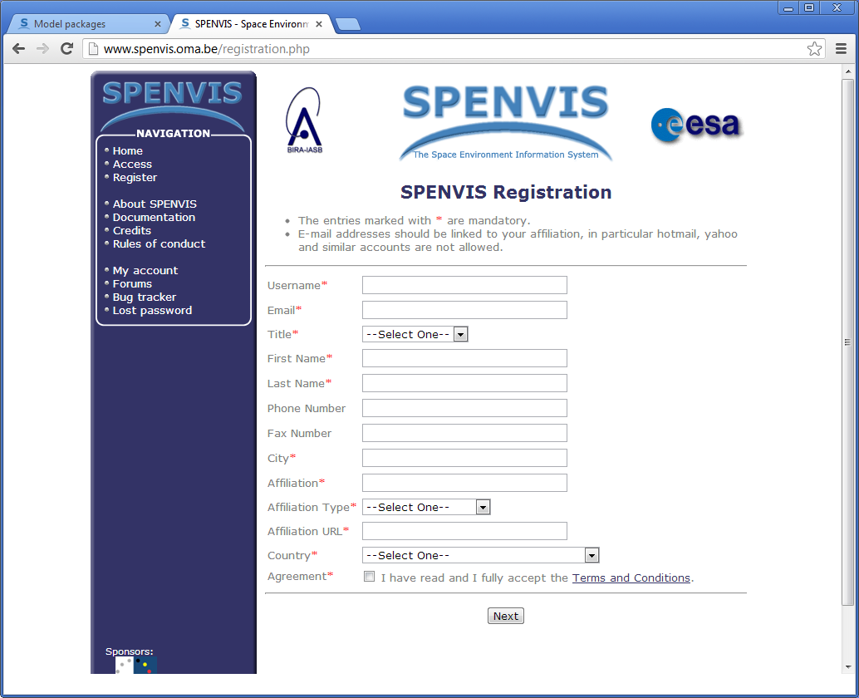
Registration
Temporary Accounts available:
juice_1
juice_2
…
juice_20
Password for each is:
juice2012

Slide 5
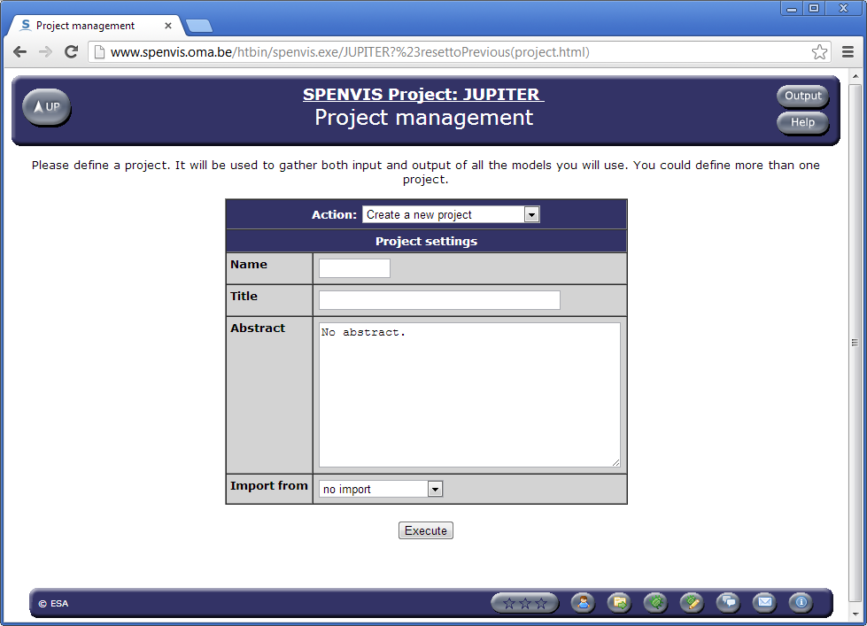
Create a Project
Link to project
management
Link to Model pages
Link to User Profile

Slide 6
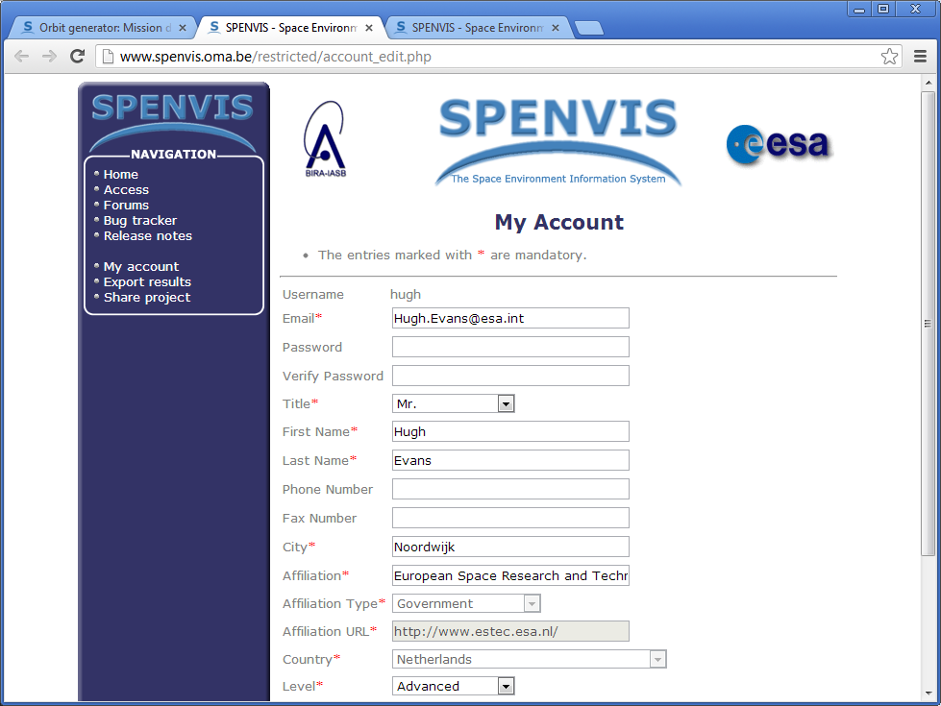
User Profile
Change to Advanced

Slide 7
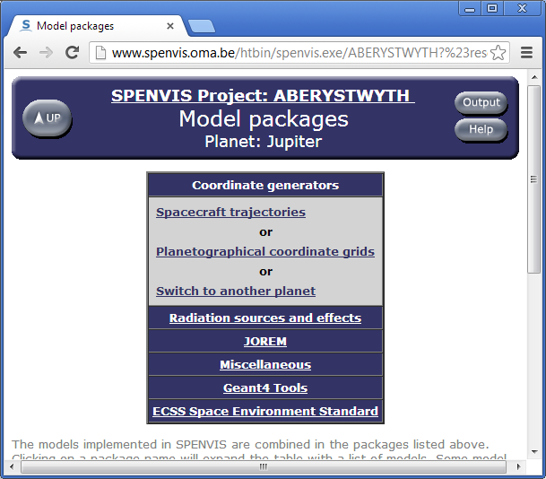
Model Home Page
Change to Jupiter

Slide 8
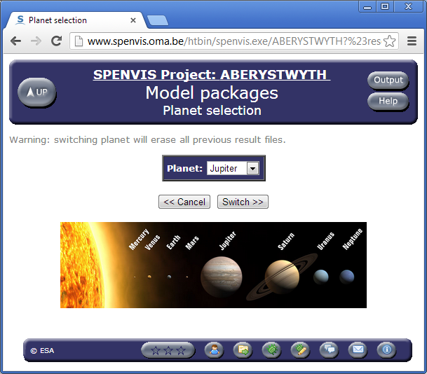
Set Project to “Jupiter”

Slide 9
A Mission Trajectory is required
Three means of specifying the trajectory:
  Orbit Generator
  Upload trajectory file (SPENVIS format)
  Upload CCSDS OEM trajectory file (JOREM extension)
Orbit generator uses ephemera and propagates the orbit
  Semi-major axis/eccentricity
  Apojove/perijove
  Hyperbolic (for fly-by missions)
SPENVIS trajectory upload has format specified in help pages:
http://www.spenvis.oma.be/help/models/sapre_upl.html
JOREM Upload available via the JOREM model section

Slide 10
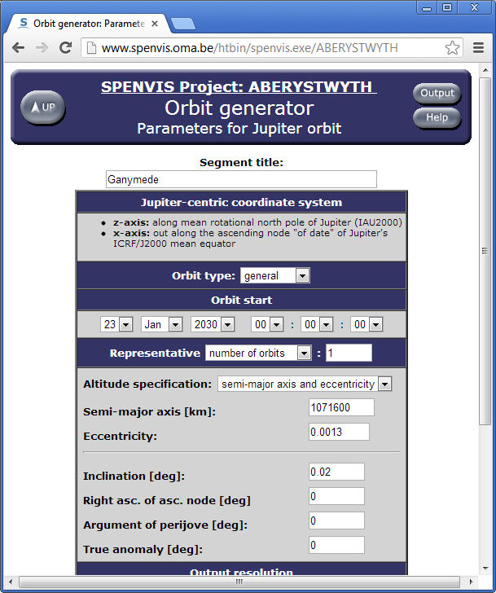
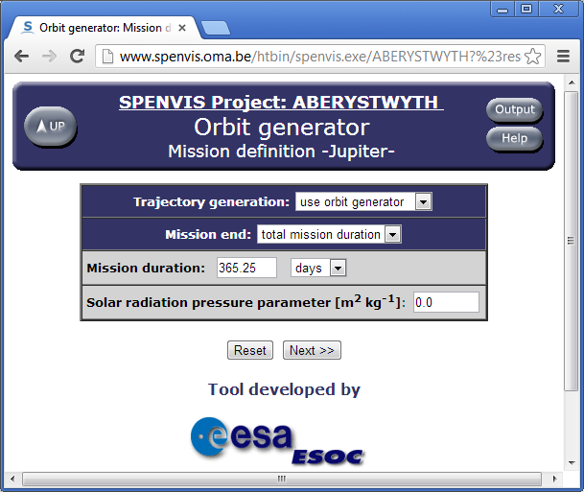
Ganymede Example

Slide 11
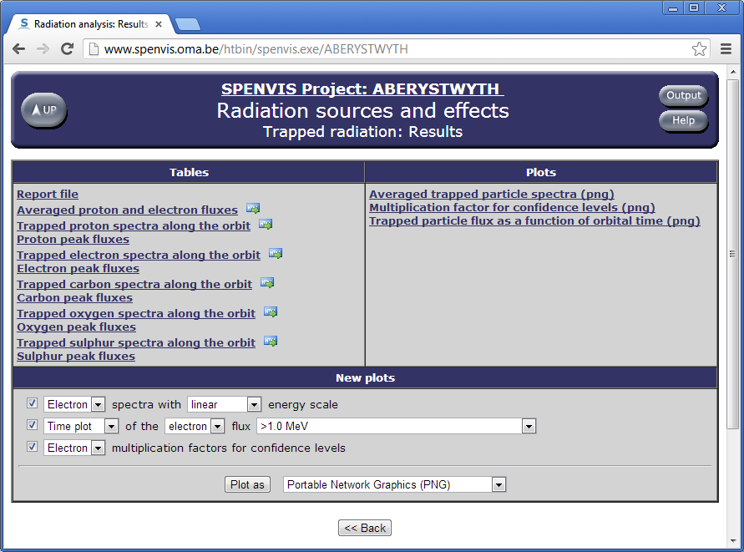
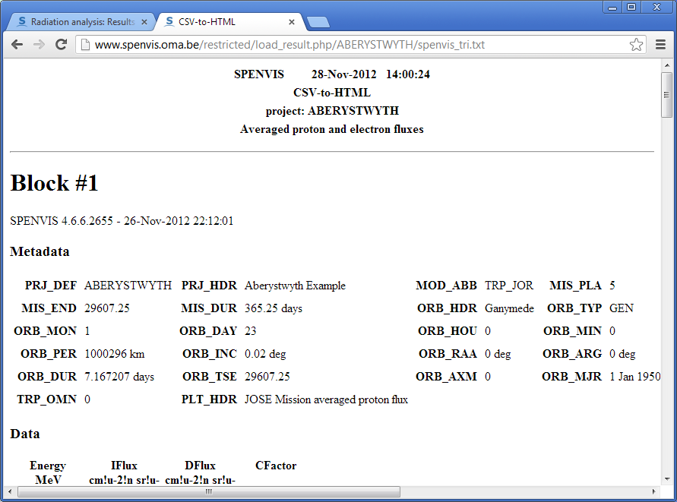
Output Pages
Link that can be used by Excel
to download CSV formatted data
as HTML tables
CSV Format defined in help pages

Slide 12
Radiation Models
Radiation sources include:
  Galactic cosmic rays
  Solar protons (long, short term)
  Trapped radiation belts (D&G, GIRE, Salammbô)
Models for all three sources in the “Radiation Sources and Effects Models”
In addition, there are the Jovian specific JOREM models:
  Electron belt
  Proton belt
  Carbon, Oxygen, Sulphur belts
  Electron background model (IEM)

Slide 13
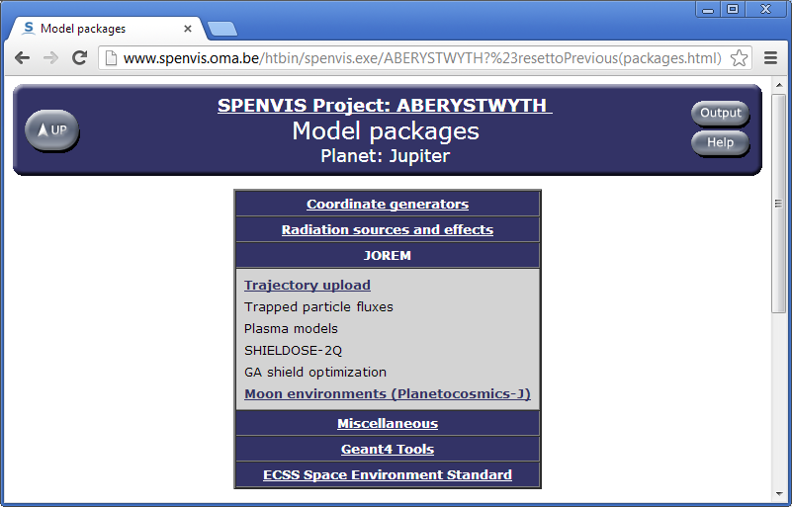
JOREM Models

Slide 14
Effects Tools
SHIELDOSE-2 Dose as function of shielding thickness (p+, e-)
SHIELDOSE-2Q
Non-Ionising dose NID as function of shielding thickness (p+, e-)
(Opto-electronic degradation)
EQFLUX/MC-SCREAM Solar cell degradation models (p+, e-)
CRÈME models SEU rate predictions (GCR, p+)
Geant4
  Mulassis Simple geometries (slab, sphere)
  GRAS Complex 3D geometries (GDML)
  SSAT Ray tracing/Sector Shielding (GDML)
  GEMAT SEU effects in components
  Generating GDML files

Slide 15
Dose Calculation
Components are rated to a dose limit, beyond which they may fail or fade.
This limit is commonly established by testing using a Cobalt-60 source – Gamma ray dose (very penetrating).
The radiation dose from the space environment is mixed (protons, electrons, cosmic rays), each with varying levels of shielding effectiveness. This rich environment is simplified into a single metric, e.g. TID, NID, etc.
It is also necessary to establish how much dose will be received by a component in the environment given the shielding available:
Simple shielding geometries (solid sphere, slab, spherical shell, etc).
Sector shielding analysis
Full physics simulations (Geant4, Fluka, etc.)

Slide 16
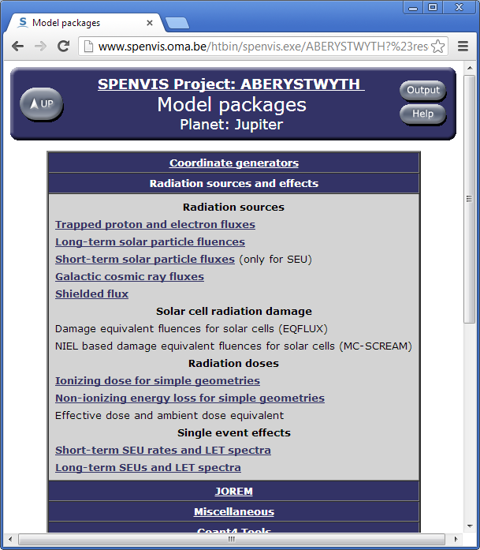
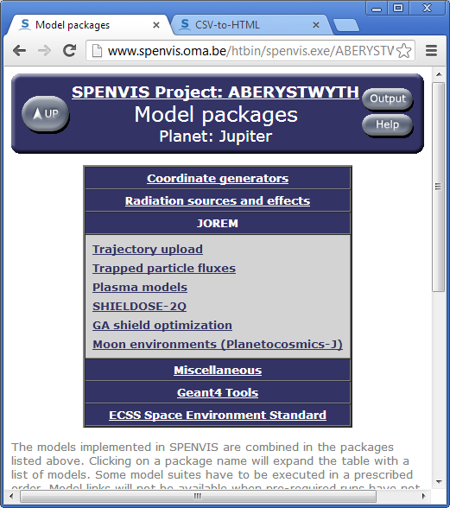
Simple Effects tools

Slide 17
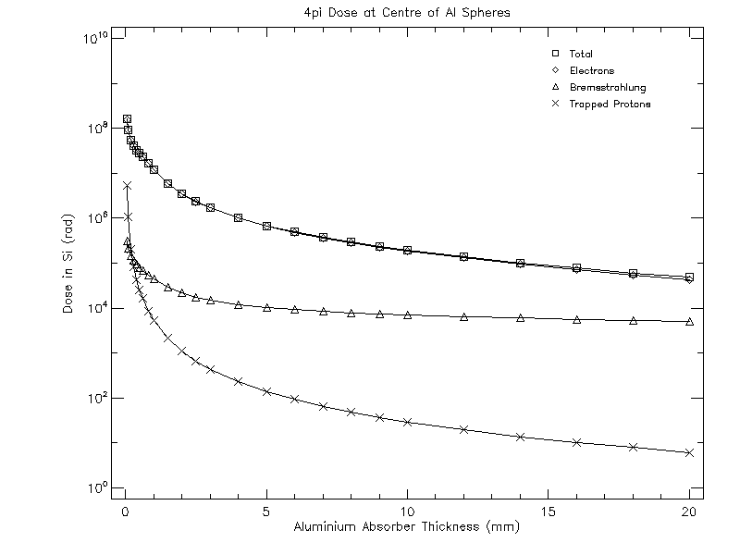
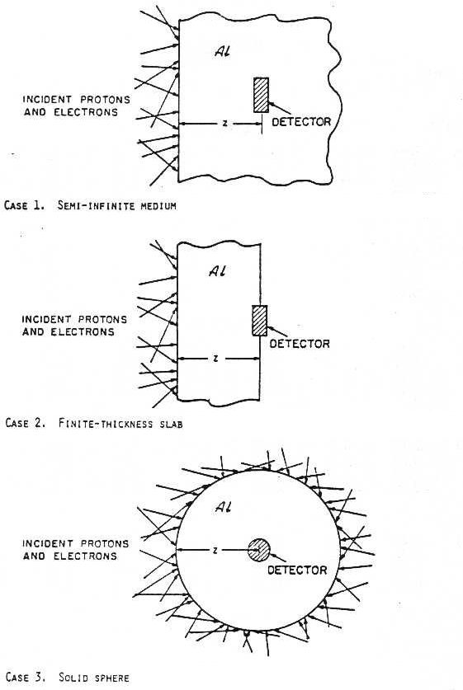
Simple Dose Effects Tools
SHIELDOSE(2,2-Q) provides dose-depth curves for simple geometries. Similarly, the NIEL model provides non-ionising doses .
This is the simplest, and most conservative approach to RHA of a component.
Generally, the solid sphere geometry is used and can serve as an input to the sector shielding approach (SSAT, FASTRAD, DOSRAD, etc.)

Slide 18
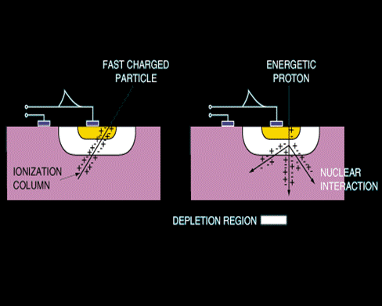
Upset Calculation - Theory
SEE are caused by GCRs and protons
SEE can be:
destructive, e.g. Latch-up, or
temporary, e.g. Single event upset/bit flip
Mechanism is species dependent:
Ions: cause upsets via ionization; this depends on the length of the ionization column in the sensitive volume of the component.
Protons: cause upsets via a nuclear interaction leading to an ionization column.
Evaluating SEE requires knowledge of component
→ Test data
(some component data included in SPENVIS)

Slide 19
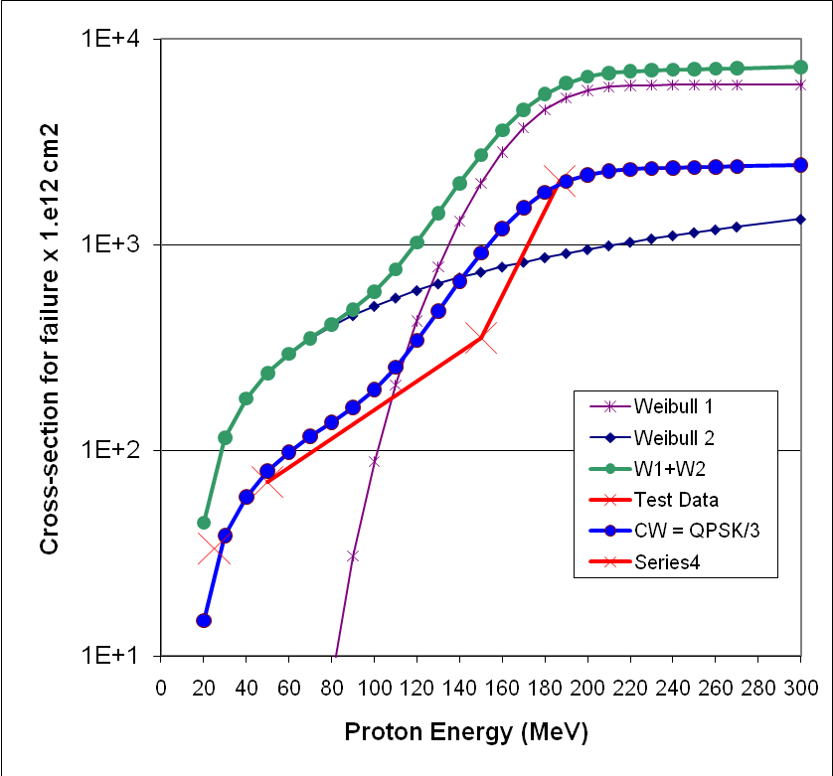
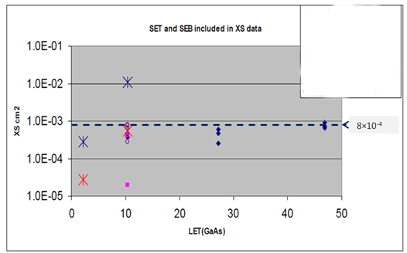
Device Test Data
Aim is to have a cross section curve as a function of incident particle LET or proton energy.
This is typically the data is fit to a Weibull or Bendel function
Proton test data
No obvious LET_{th}
Test saturation cross section
matches the visual inspection
Heavy Ion test data

Slide 20
Upset Calculation - Ions
CREME 86/96 RPP method:
  Device Dimensions (l×w×h) → RPP path length distribution. These dimensions are derived from actual device dimension measurements, the cross section test data and device thickness.
  Critical Charge (Q_{c}) – proportional to LET_{th}.
  Cross section: is from the device test data.
N.B.: 22.5 is for Silicon, for GaAs this becomes 30.0

Slide 21
Upset Calculation - Theory
Protons: CREME 86/96 method:
  Cross-section data (Bendel, Weibull, Profit)
  In principle, there are no angular effects to consider.

Slide 22
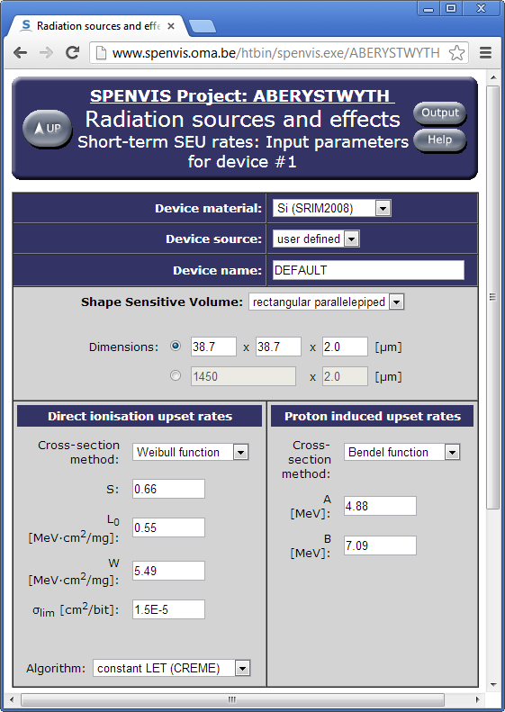
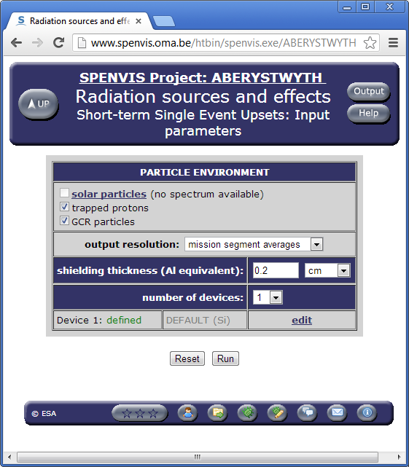
SEE in SPENVIS

Slide 23
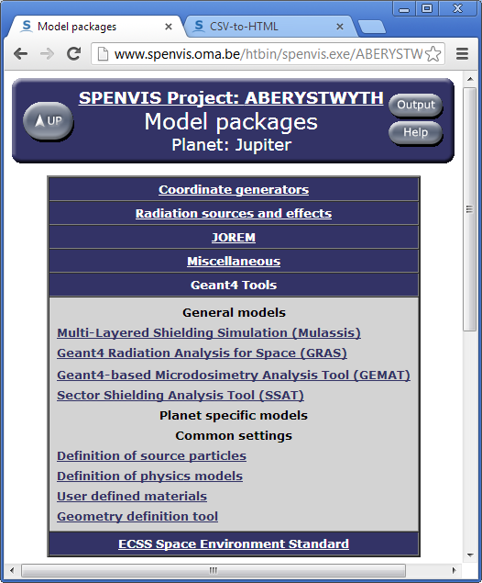
Geant4 Models
Geant4 tools have similar inputs
Source particle definitions
Physics lists
Material lists
Geometry (GRAS, SSAT)
Mulassis & GEMAT have their
own geometry definitions.
Geant4 input files (macros & GDML) available for download to permit local runs.

Slide 24
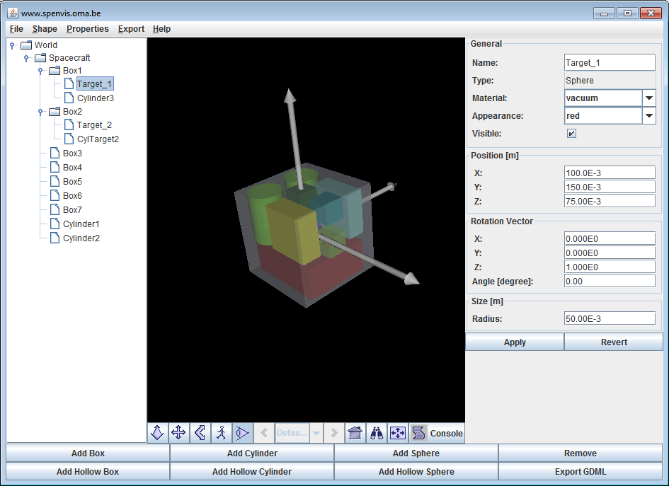
Geometry Definition (GDML)
Two tools available to generate simple GDML geometries:
HTML based Geometry Definition tool
  Series of HTML pages to specify a geometry with up to 10 elements using CSG (sphere, box, cylinder)
  Visualisation available at each step using VRML (need plug in, such as Cortona (http://www.cortona3d.com/)
Java Geometry Generation Tool
  Downloaded Java application
  Interactive visualisation
Upload GDML file from CAD tool,
e.g. FASTRAD.

Slide 25
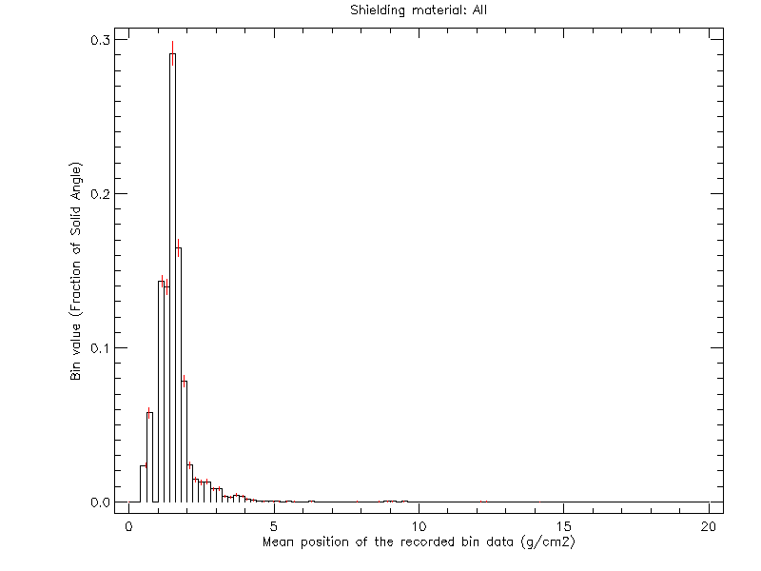
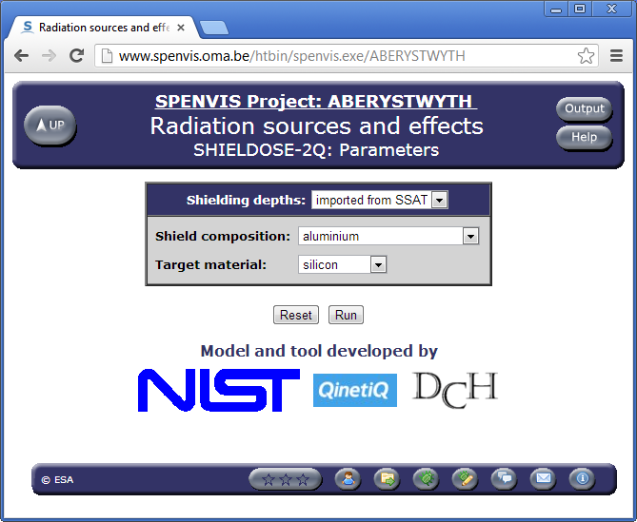
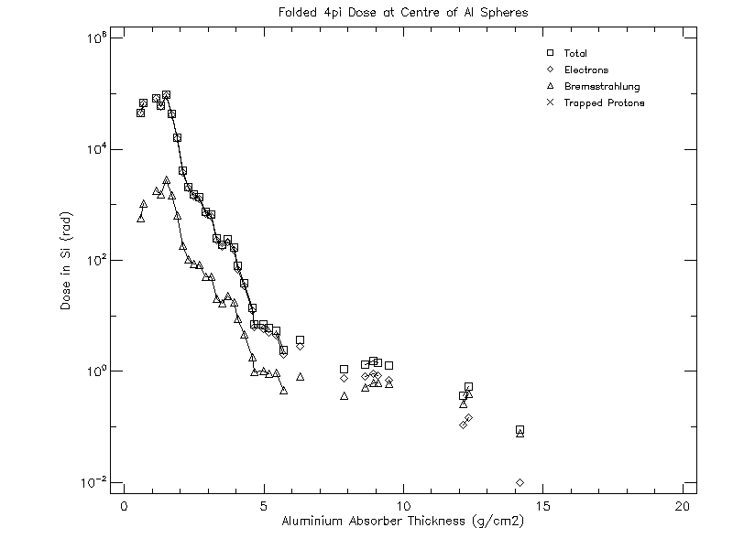
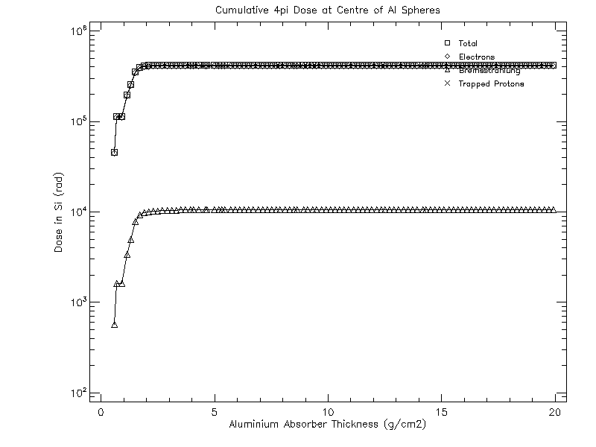
Sector Shielding Doses (SSAT)
Run SSAT to derive shielding distribution curve
Use SHIELDOSE-2 or SHIELDOSE-2Q and import shielding depths from SSAT.
Running SD2(Q) will fold Shielding distribution curve with the Dose-depth curve to provide Dose contribution for each shielding thickness for the geometry. The cumulative curve gives the dose in the target.
Look in SSAT GDML file analysis to find location of target (not obvious)

Slide 26
Mulassis
Simple geometries, like Shieldose:
  Slab
  Spherical shells (solid sphere)
Can be used to investigate graded,
or exotic shields and targets.
Outputs include:
  Shielded flux spectra
  Total Ionising dose
  Non-Ionising dose
  Pulse height spectrum
  Dose Equivalent
  (Human effects)
Recommend using slab geometries, as statistics are better. Although for solid sphere equivalent, an good approximation (~10%) is to use a spherical shell with a vacuum “core” that’s 1/10th the thickness of shield.

Slide 27
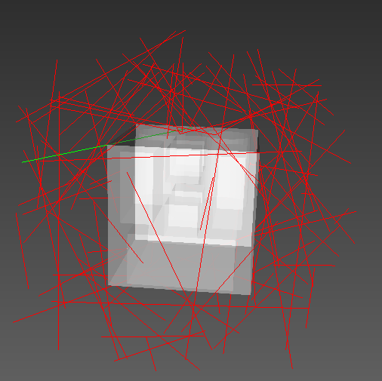
GRAS
Complex 3D analysis module
Geometry defined by GDML file
Targets selected from GDML file
Can use the SPENVIS system to
set up a basic run, download the
input files and run more detailed
analysis locally.
SPENVIS limits model runs to 600s,
Which can often be insufficient for a complex geometry to be analysed with adequate statistics.

Slide 28
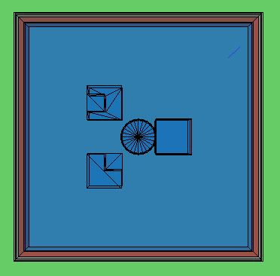
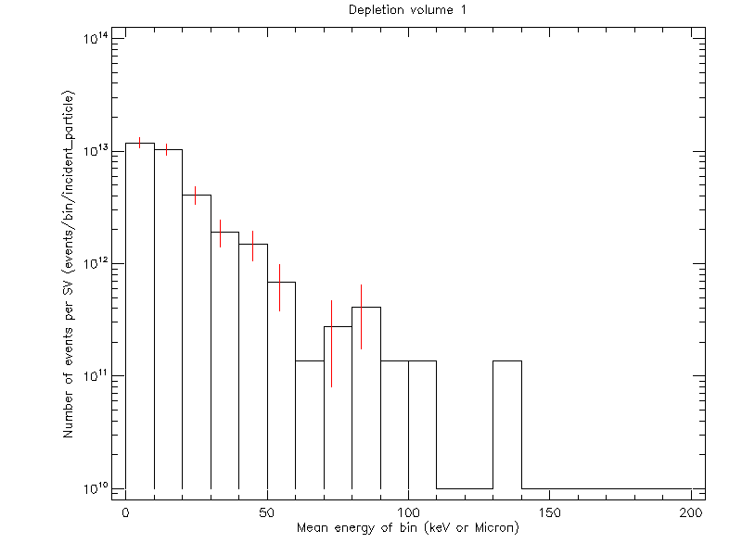
GEMAT
Used to study the effects of radiation on
micro-electronics (Single Event Effects).
A geometry is defined for a component
in terms of layers. Using common shapes
cylinder, box, “L” and
“U” shapes
Analysis of
  incident flux
  Pulse height
Allows analysis of more
complex geometries than
provided by CREME.

Slide 29
JOREM tools
SHIELDOSE-2Q
  Same methods as SHIELDOSE-2
  Energies of electrons extended
  More shielding compositions (Al, Ti, Fe, Ta, CW80, Al+Ta dual layer)
  More target materials.
Genetic Algorithm for shielding optimisation
  Uses GA to optimise shielding layered geometries
  Fitness function based on mass, thickness, TID, NID.
  Particle spectra from Environment models.
Moon Environment analysis (Planetocosmics-J)

Slide 30
Advice
The SPENVIS system, being an on-line system, limits model runs to only 600 CPU seconds.
The JOREM Radiation models can take a significant time to run – sample the orbit of interest, use a single orbit at, e.g. Ganymede. Don’t try to simulate the entire mission with a 60s time resolution.
Normally only 2 projects are provided to users, this can be increased by request to the SPENVIS team
Similarly, CPU limits and disk usage can be extended beyond the default on request.
Forums are available for assistance.
ECSS Standard Resources:
  ECSS-E-ST-10-12C: valuable resource for determining effects
  ECSS-Q-ST-60-15C: Radiation Hardness Assurance standard
For RHA – a margin of a factor of 2 should suffice.

