Slide 1
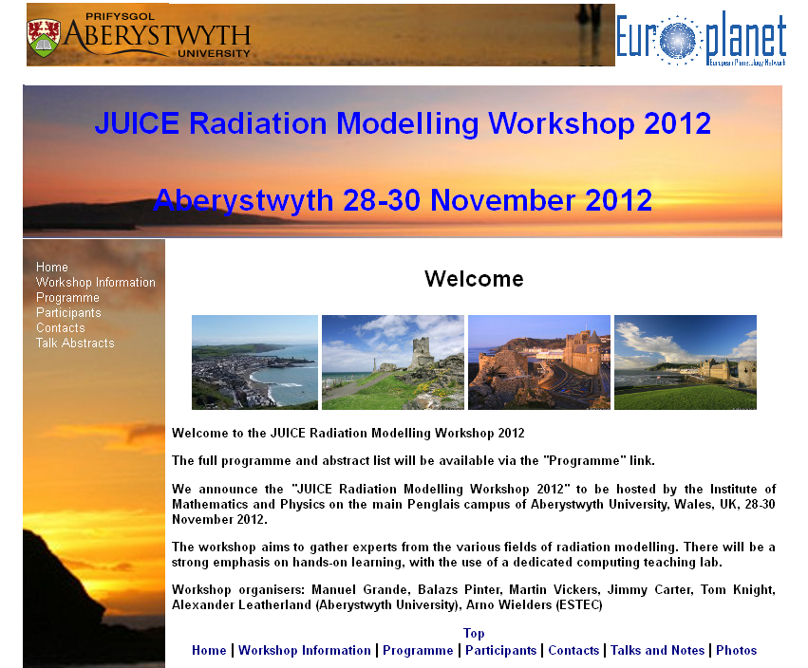

Slide 2
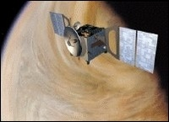
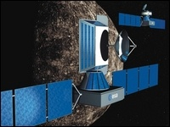
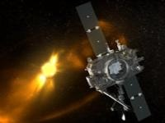

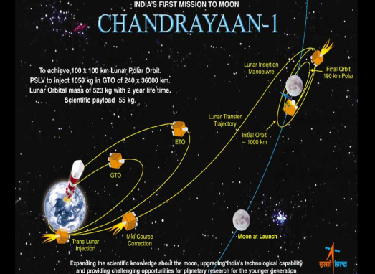
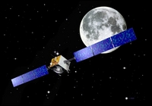
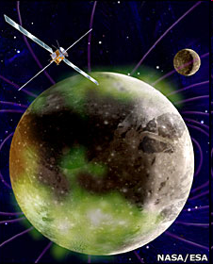
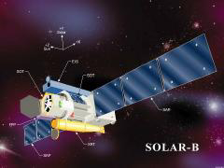
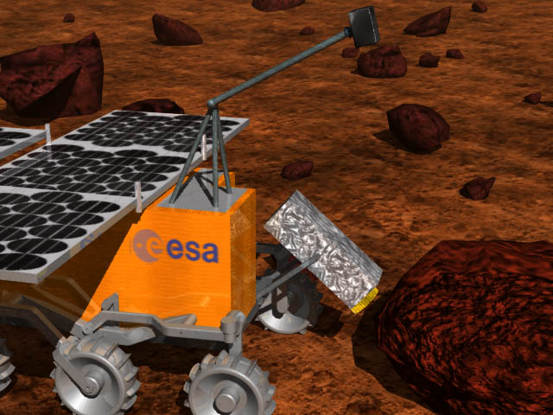
Aberystwyth in Space – the Moon
ExoMars
Chandrayaan
STEREO
Bepi
VEX
Solar B
LoFAR
Laplace/EJSM

Slide 3
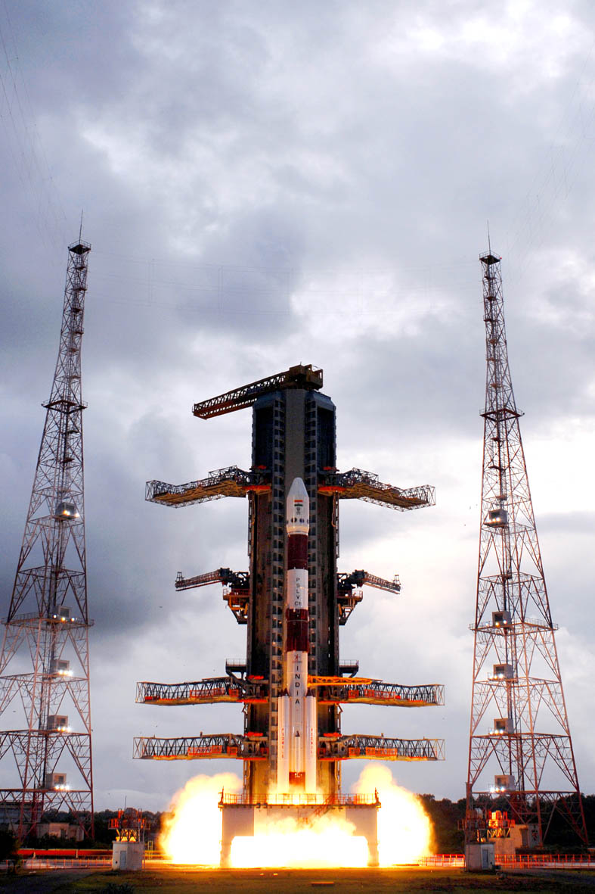


Aberystwyth returns to the Moon
Chandrayaan 1
India’s first mission to the Moon
Manuel Grande

Slide 4
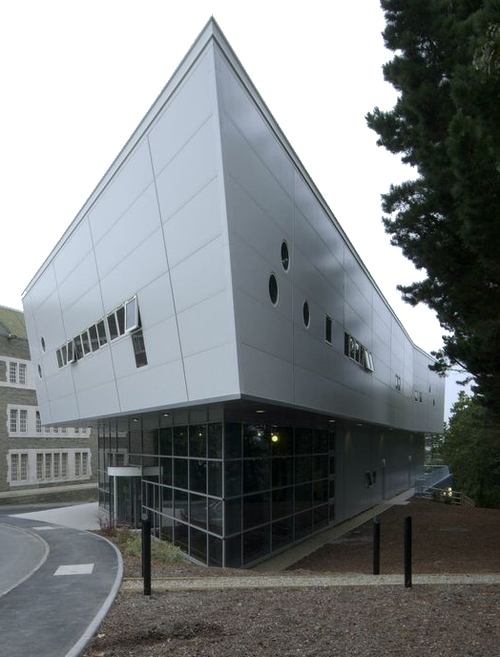
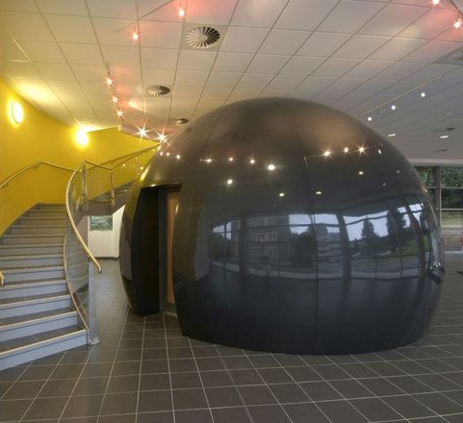


High Power Computing, Remote Sensing and Cartography

Slide 5
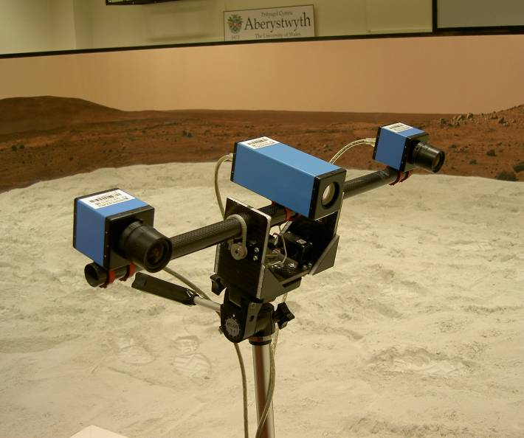
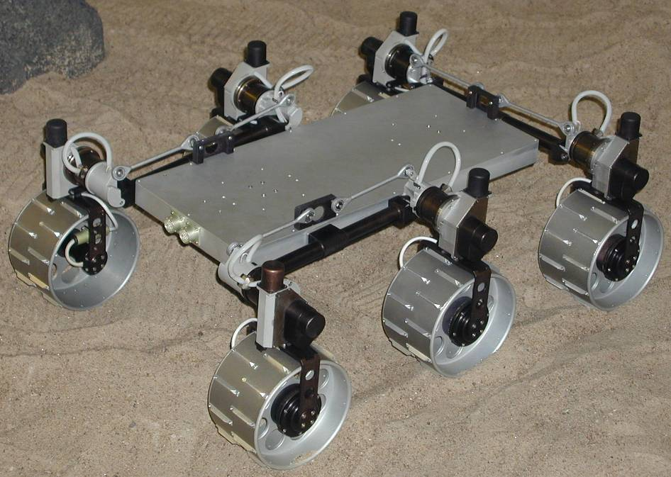
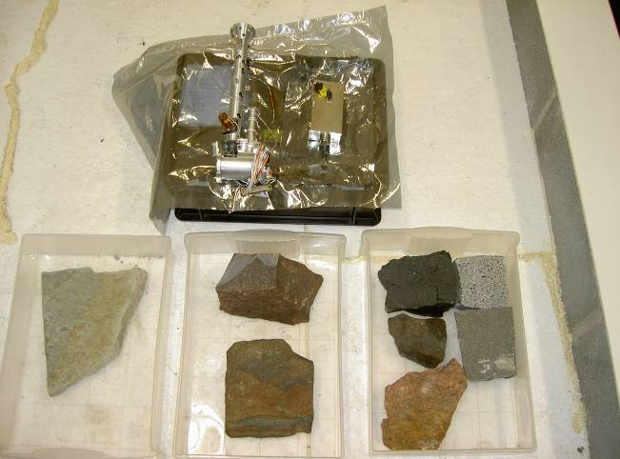
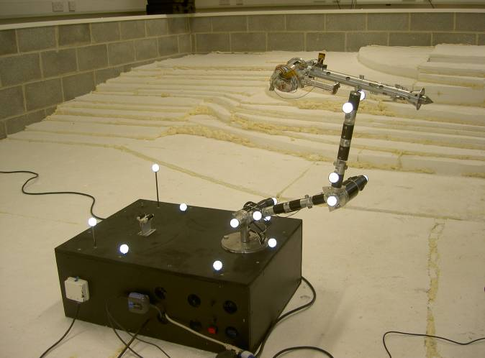
UWA Planetary Analogue Terrain Laboratory (PAT Lab.) - 2
Part of PAT
Lab. with
DLR Mars
soil
simulant-D
UWA
PanCam
(can be
mounted
on chassis)
Small
selection of
instruments
and science
target rocks
Link with
PAFS-NET
UWA 3
DoF ARM
and DLR
Mole (can be
mounted
on chassis)

Slide 6
DAY | TIME | EVENT
Wednesday | 1400-1500 | Welcome | Prof Manuel Grande
 | 1500-1600 | Keynote Talk: Influence of Ganymede regarding radiation dose induced by energetic electrons for the JUICE mission | Nicolas Andre
 | 1600-1630 | Coffee
 | 1630-1650 | Participant Talk: Radiation modeling infrastructure and methods for JUICE at IRF-Kiruna | Stefan Karlsson
 | 1650-1710 | Participant Talk: Particle detectors in the Jovian environment | Joan Stude
 | 1710-1730 | Participant Talk: Some results on radiation modeling of the Particle Environment Package (PEP) instrument | Stas Barabash

