Slide 1
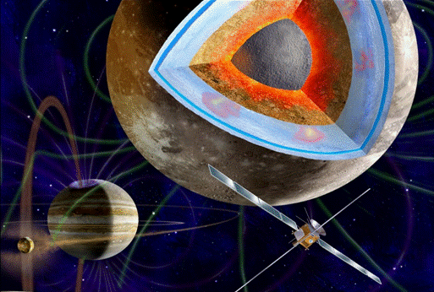
Introduction
Introduction
Overarching questions
JUICE
JUICE concept
European-led mission to the Jovian system
Two Europa flybys and high-inclination phase at Jupiter
First orbiter of an icy moon
JUICE Science Themes
Emergence of habitable worlds around gas giants
Jupiter system as an archetype for gas giants

Slide 2
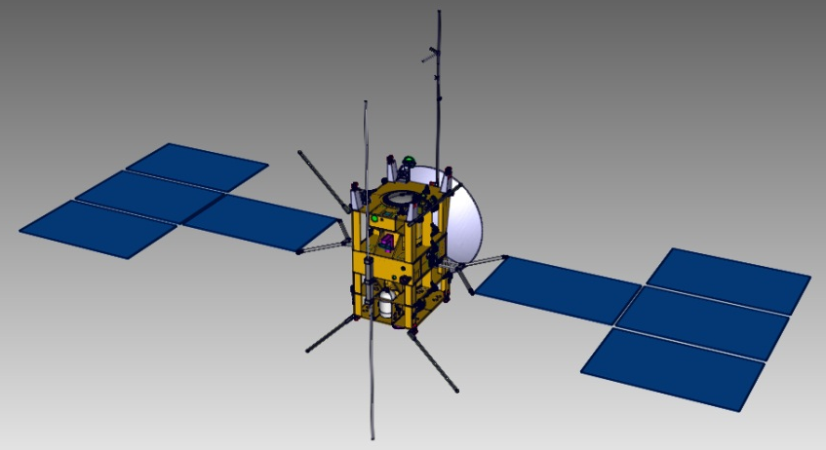
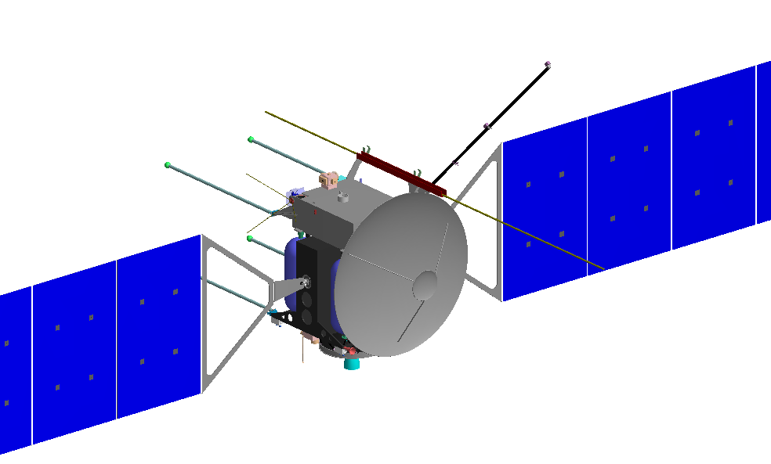
Mission design
JUICE
Spacecraft Design
Model instruments
Mission phases
Option 1
Dry mass ~1900 kg, propellant mass ~2900 kg
High Δv required: 2600 m/s
Model payload 104 kg, ~120 – 150 W
3-axis stabilized s/c
Power: solar array 60 – 70 m², 640 – 700 W
HGA: >3 m, fixed to body, X & Ka-band
Data return >1.4 Gb per 8 h pass (one ground station)
Option 2
Option 3

Slide 3
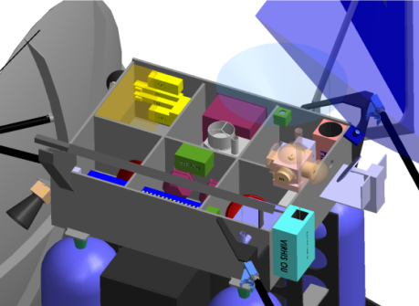
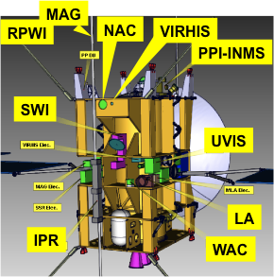
JUICE Model Payload
Mission design
JUICE
Spacecraft Design
Model instruments
Mission phases
Imaging
Narrow Angle Camera (NAC) | 10 kg
Wide Angle Camera (WAC) | 4.5 kg
LA
WAC
NAC
Option 3
PPI-INMS
Spectroscopy
Visible Infrared Hyperspectral Imaging Spectrometer (VIRHIS) | 17 kg
UV Imaging Spectrometer (UVIS) | 6.5 kg
Sub-mm Wave Instrument (SWI) | 9.7 kg
SWI
Option 2
UVIS
VIRHIS
In situ Fields and Particles
Magnetometer (MAG) | 1.8 kg
Radio and Plasma Wave Instr. (RPWI) | 11.2 kg
Particle and Plasma Instrument - Ion Neutral Mass Spectrometer (PPI-INMS) | 18.2 kg
Option 1
Sounders & Radio Science
Laser Altimeter (LA) | 11 kg
Ice Penetrating Radar (IPR) | 10 kg
Radio Science Instrument (JRST+USO) | 4 kg
Model payload is based on heritage: BepiColombo, Juno, Mars Express, Double Star, Venus Express, Rosetta, Dawn, Cassini, etc…
Total mass: 104 kg

Slide 4
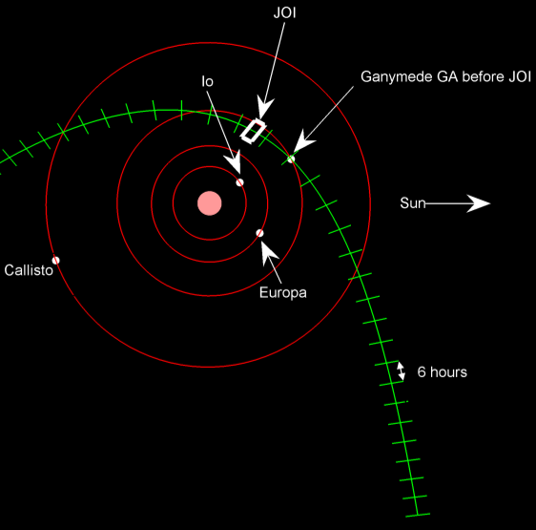
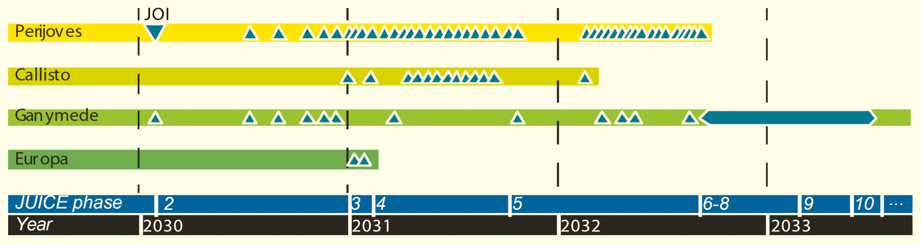
JUICE Mission Profile – phase 2 – in the Jupiter system
Mission design
JUICE
Spacecraft Design
Model instruments
Mission phases
Launch | June 2022 (August 2023)
Interplanetary transfer (Earth-Venus-Earth_Earth) | 7.6 years (8 years)
Jupiter orbit insertion and apocentre reduction with Ganymede gravity assists | 11 months

Slide 5
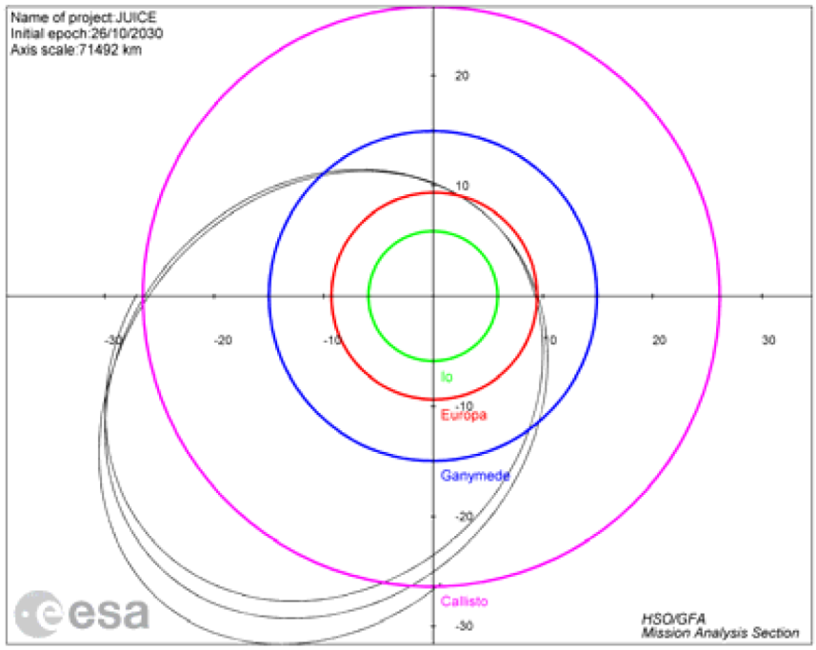
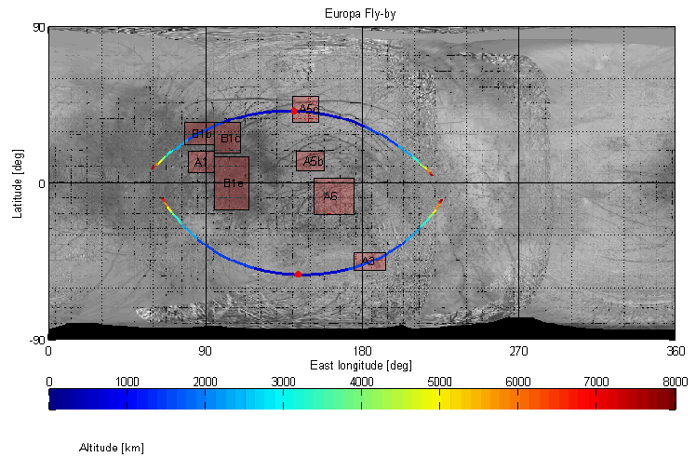
Mission design
JUICE
Spacecraft Design
Model instruments
Mission phases
Launch | June 2022
Interplanetary transfer (Earth-Venus-Earth_Earth) | 7.6 years
Jupiter orbit insertion and apocentre reduction with Ganymede gravity assists | 11 months
2 Europa flybys | 36 days
Europa
East longitude
90
180
270
Altitude
1000
2000
3000
4000
5000
6000
7000
8000 km

Slide 6
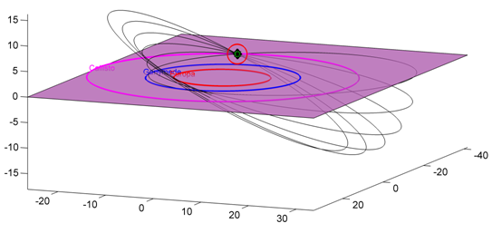
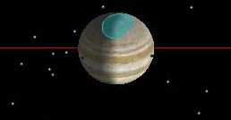
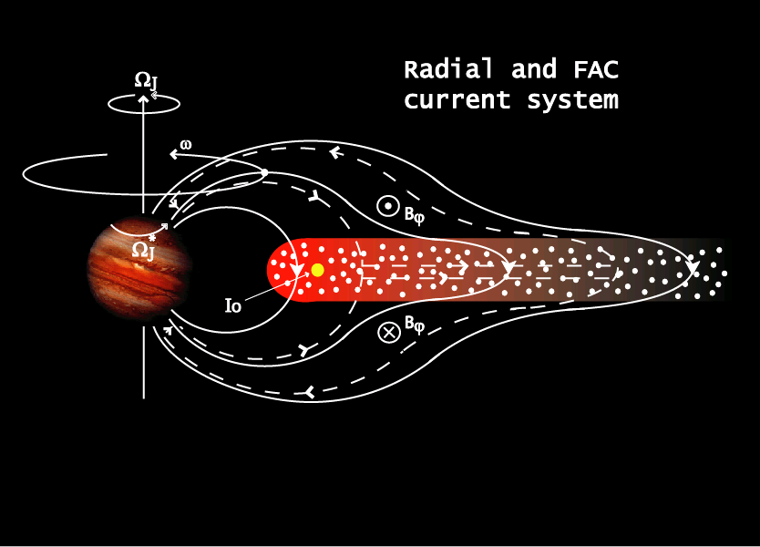
JUICE Mission Profile – phase 4 – Callisto + high latitudes
Mission design
JUICE
Spacecraft Design
Model instruments
Mission phases
Launch | June 2022
Interplanetary transfer (Earth-Venus-Earth_Earth) | 7.6 years (8 years)
Jupiter orbit insertion and apocentre reduction with Ganymede gravity assists | 11 months
2 Europa flybys | 36 days
Reduction of v_{inf} (Ganymede, Callisto) | 60 days
Increase inclination with 10 Callisto gravity assists | 200 days
Callisto

Slide 7
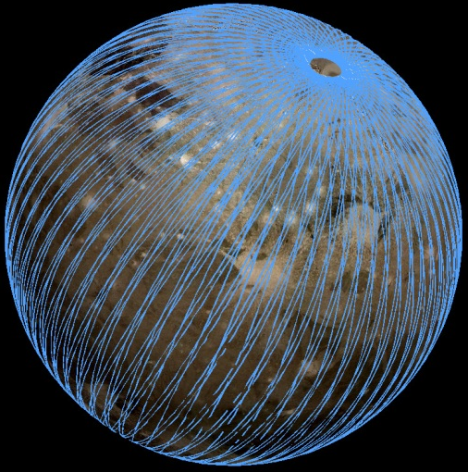
JUICE Mission Profile – phases 5-10 - Ganymede
Mission design
JUICE
Spacecraft Design
Model instruments
Mission phases
Launch | June 2022
Interplanetary transfer (Earth-Venus-Earth_Earth) | 7.6 years
Jupiter orbit insertion and apocentre reduction with Ganymede gravity assists | 11 months
2 Europa flybys | 36 days
Reduction of v_{inf} (Ganymede, Callisto) | 60 days
Increase inclination with 10 Callisto gravity assists | 200 days
Callisto to Ganymede | 11 months
Ganymede (polar) 10,000x200 km & 5000 km 500 km circular 200 km circular | 150 days 102 days 30 days
Total mission at Jupiter | 3 years
7
9-10
6
8

Slide 8
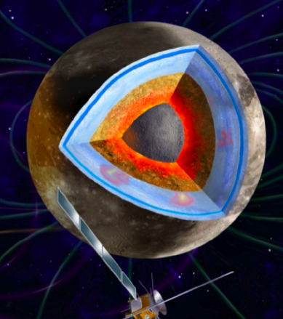
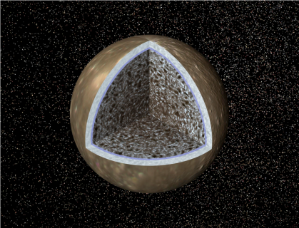
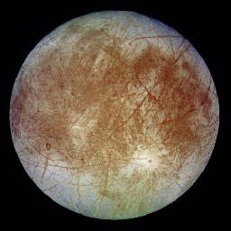
Exploration of the habitable zone
JUICE
Three large icy moons to explore
Ganymede
Largest satellite in the solar system
A deep ocean
Internal dynamo and an induced magnetic field – unique
Richest crater morphologies
Best example of liquid environment trapped between icy layers
Callisto
Best place to study the impactor history
Differentiation – still an enigma
Only known example of non active but ocean-bearing world
The witness of early ages
Europa
A deep ocean
An active world?
Best example of liquid environment in contact with silicates

Slide 9
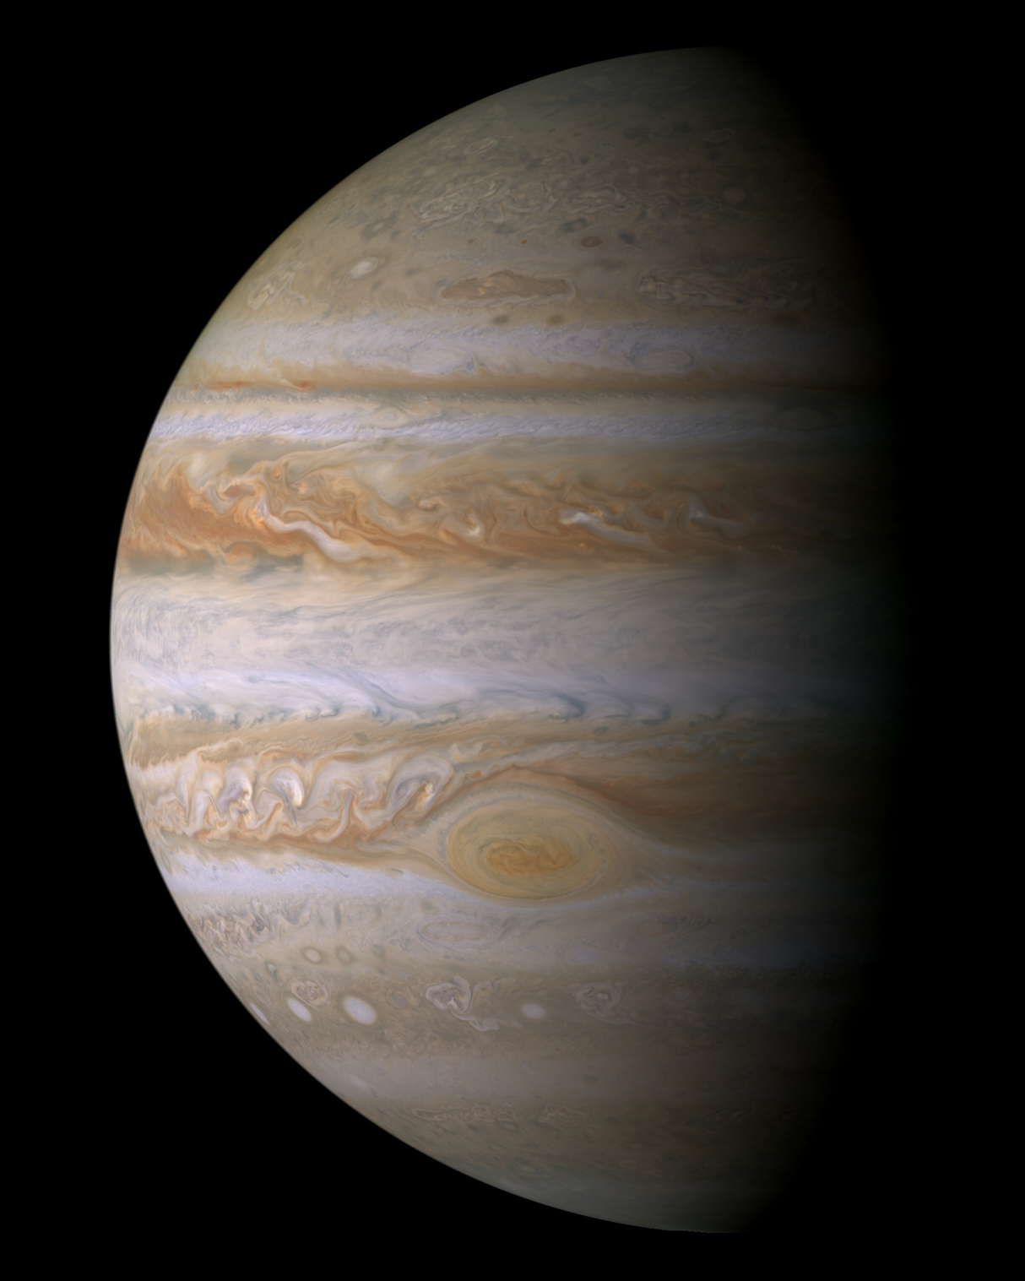
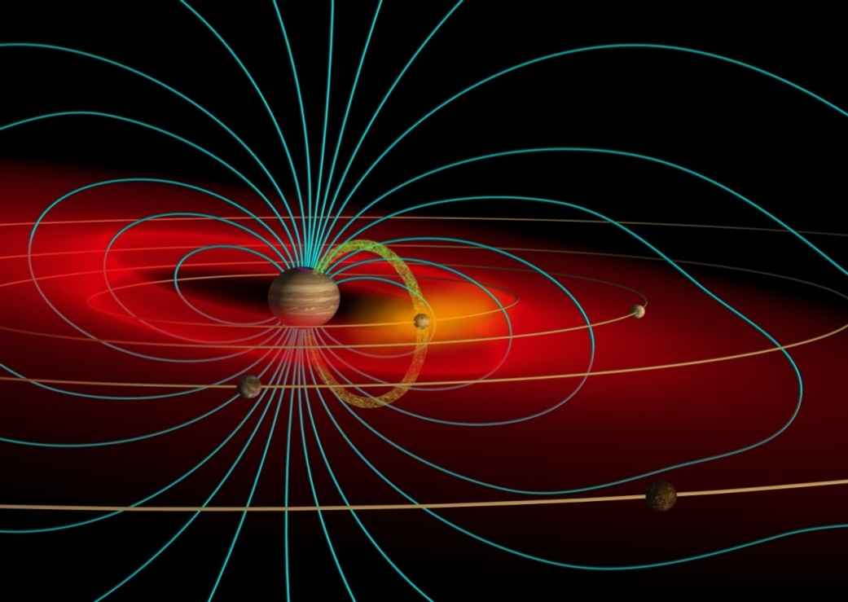
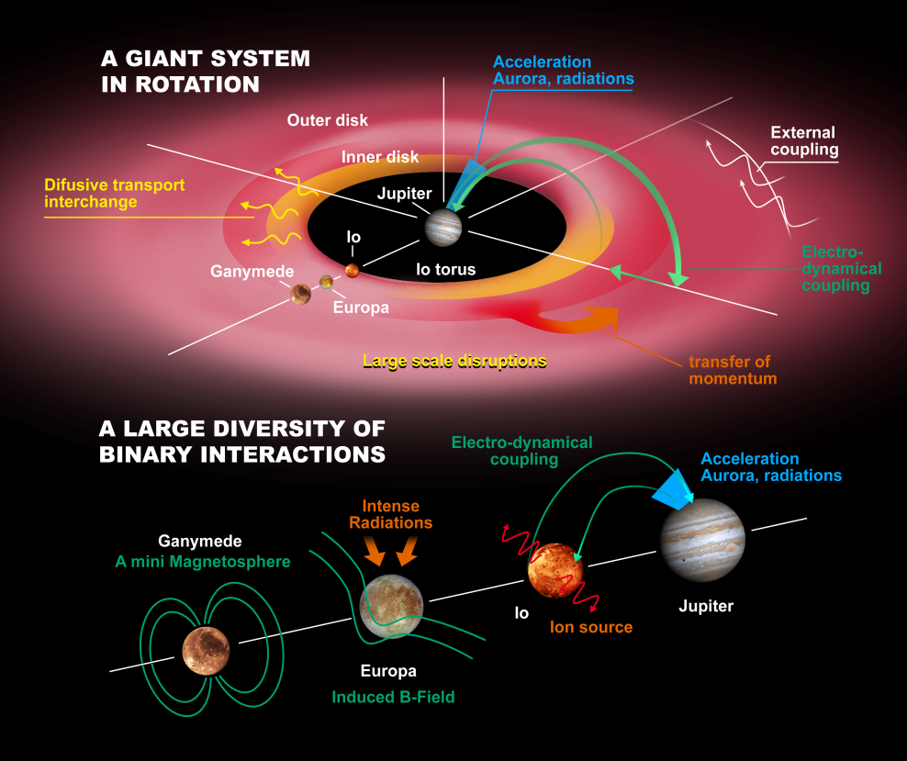
Exploration of the Jupiter system
JUICE
The biggest planet, the biggest magnetosphere, and a mini solar system
Jupiter
Archetype for giant planets
Natural planetary-scale laboratory for fundamental fluid dynamics, chemistry, meteorology,...
Window into the formational history of our planetary system
Magnetosphere
Largest object in our Solar System
Biggest particle accelerator in the Solar System
Unveil global dynamics of an astrophysical object
Coupling processes
Hydrodynamic coupling
Gravitational coupling
Electromagnetic coupling
Satellite system
Tidal forces: Laplace resonance
Electromagnetic interactions to magnetosphere
and upper atmosphere of Jupiter
Laplace resonance

Slide 10
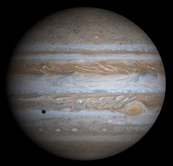
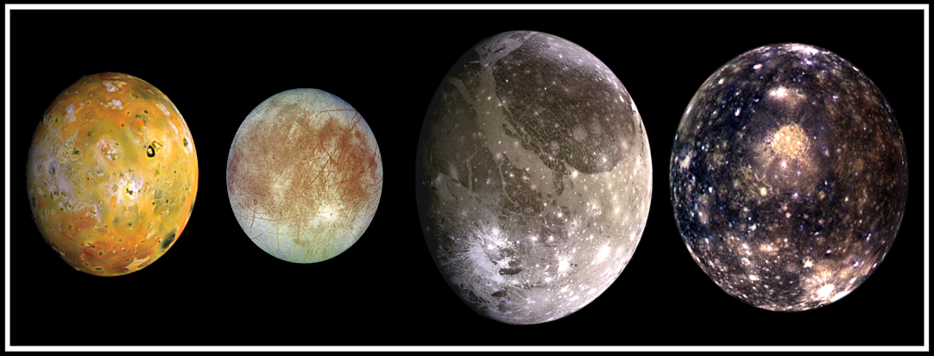
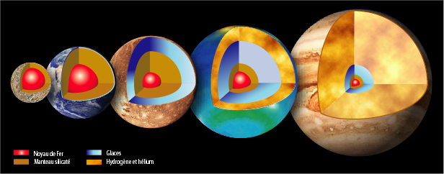
From the Jovian system to extrasolar planetary systems
JUICE
Waterworlds and giant planets
Habitable worlds
Astrophysics Connection
At Ganymede, JUICE will characterise an entire family of exoplanets: the waterworlds.
At Jupiter, JUICE will further explore an archetype for giant exoplanets.
Jupiter system
Three waterworlds
One giant planet
Ganymede
Jupiter
Exoplanets
Five families
> 800 planets
Earth-like
Waterworlds
Iron-rich
Uranus
Neptune
Jupiter
Saturn
B1257
+12A
Kepler 22b
GJ1214b
>140
>530
SUPER-EARTHS
INTERMEDIARY
GIANTS

Slide 11
From the Jupiter system to extrasolar planetary systems
JUICE
Waterworlds and giant planets
Habitable worlds
Astrophysics Connection
Surface habitats
Deep habitats
Deep habitats

Slide 12
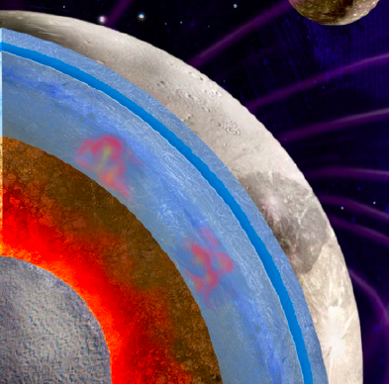
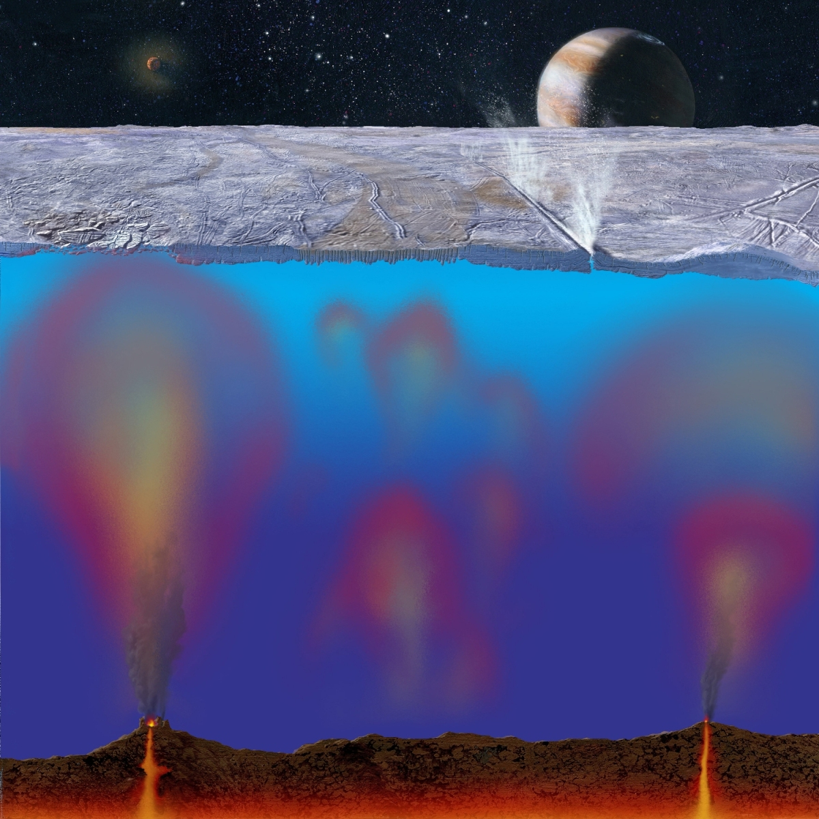
From the Jupiter system to extrasolar planetary systems
JUICE
Waterworlds and giant planets
Habitable worlds
Astrophysics Connection
Waterworlds: If habitable, the liquid layers are trapped between two icy layers
Europa-like: If habitable, the liquid layers may be in contact with silicates as on Earth
Occurrence:
Largest moons, hot ice giants, ocean-planets…
Most common habitat in the universe ?
Occurrence:
Europa, Enceladus
Only possible for very small bodies
Key question:
Are these waterworlds habitable ?
Key question:
How are the surface active areas related to potential deep habitats?
What JUICE will do:
Via characterisation of Ganymede, will constrain the likelihood of habitability in the universe
What JUICE will do:
Pave the way for future landing on Europa
Better understand the likelihood of deep local habitats

Slide 13
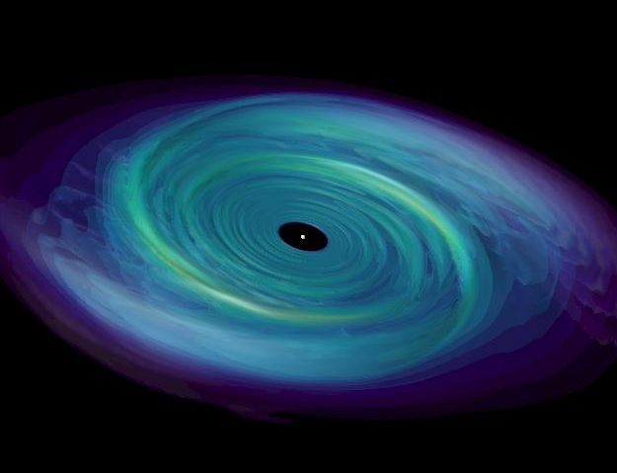
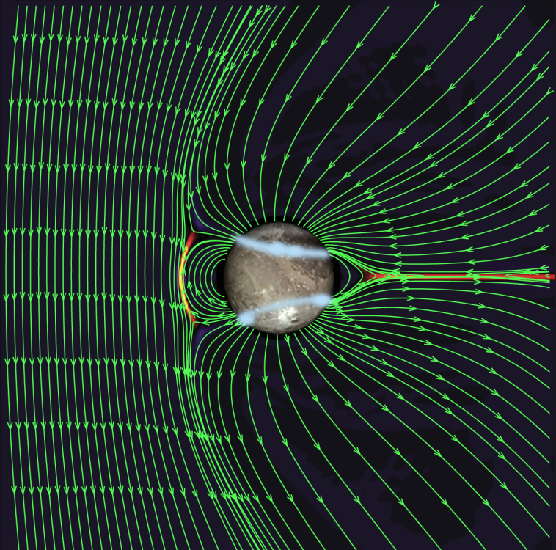
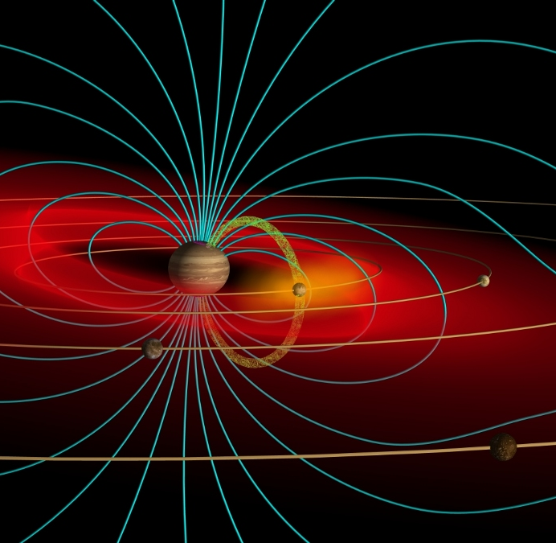
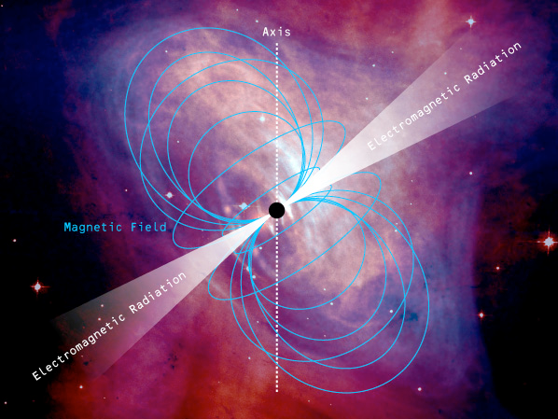
From the Jupiter system to extrasolar planetary systems
JUICE
Waterworlds and giant planets
Habitable worlds
Astrophysics Connection
Most of the ordinary (baryonic) matter in the universe is a plasma, controlled by the fundamental electromagnetic force. It makes the Sun and stars, influences the environments of the Earth and other planets, and pervades the solar system, galaxies, and inter-galactic space.
What are the fundamental processes that transport, convert, and release energy in plasmas?
Magnetic reconnection
Jupiter’s spinning magnetodisc
Accretion discs
Ganymede’s mini-magnetosphere
Jupiter’s ‘mass-loaded’ system
Pulsars

Slide 14
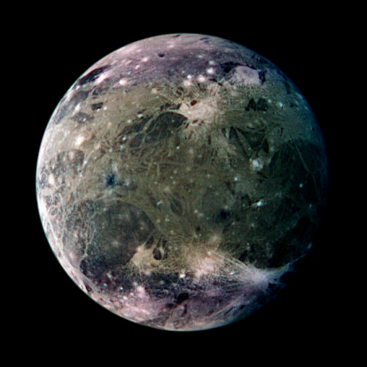
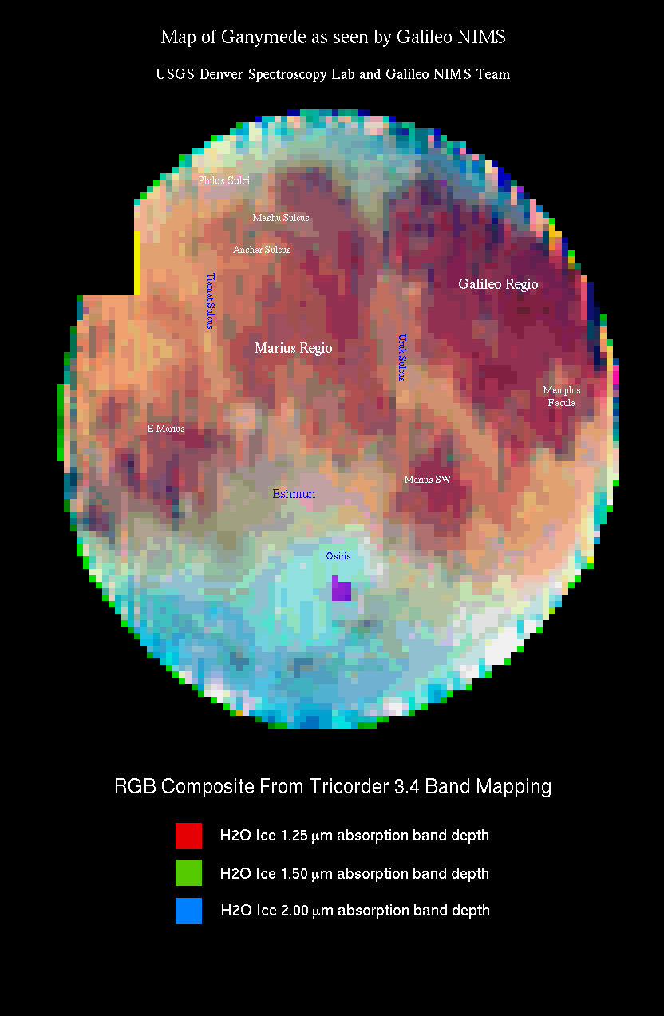
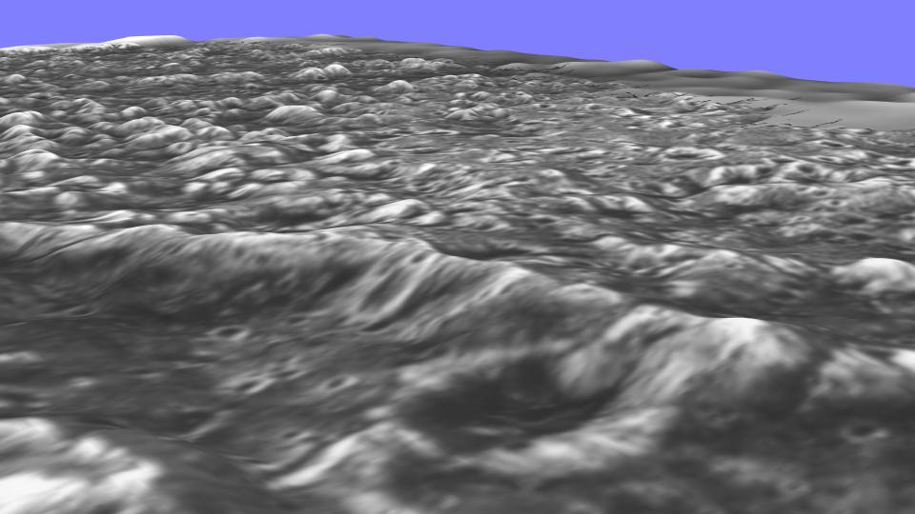
Liquid water
Exploration of the habitable zone
Characterise Ganymede as a planetary object and possible habitat
Galileo Regio
JUICE OBJECTIVES
Characterise the ice shell, the extent of the ocean and its relation to the deeper interior
Determine global composition, distribution and evolution of surface materials
Understand the formation of surface features and search for past and present activity
Characterise the local environment and its interaction with the Jovian magnetosphere

Slide 15
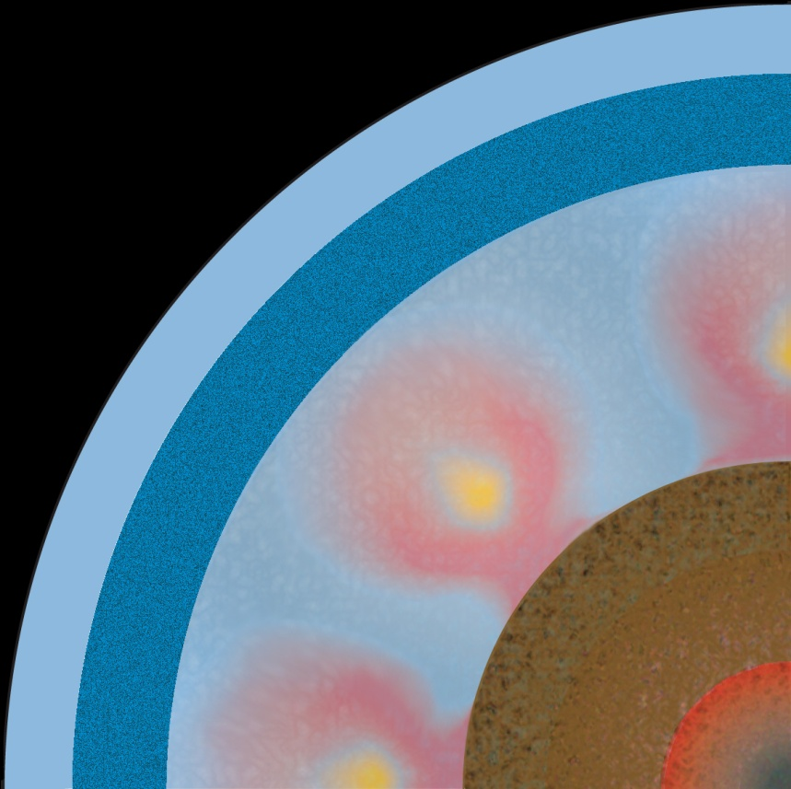
Liquid water
Characterise Ganymede as a planetary object and possible habitat
1. Extent of the ocean and its relation to the deeper interior
Internal structure
Surface
deformations
Rotation
Icy crust
Liquid
layer
Magnetic induction
Ocean thickness (km)
Icy mantle
Silicates
Metallic core
Crust thickness (km)
JUICE measurements
Instrument Packages
  In situ Fields and Particles
  Imaging
  Sounders and Radio Science
Surface deformations
Rotation
Magnetic induction

Slide 16
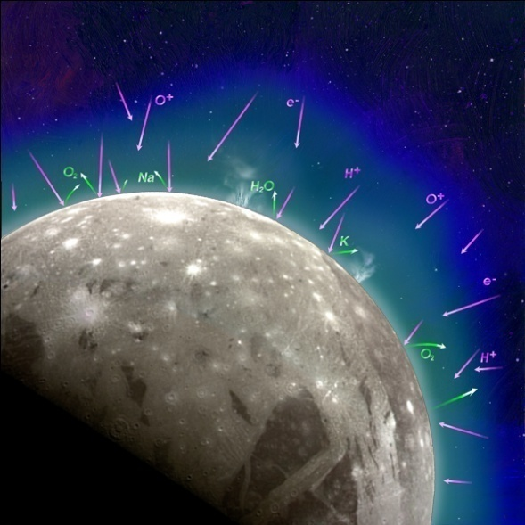
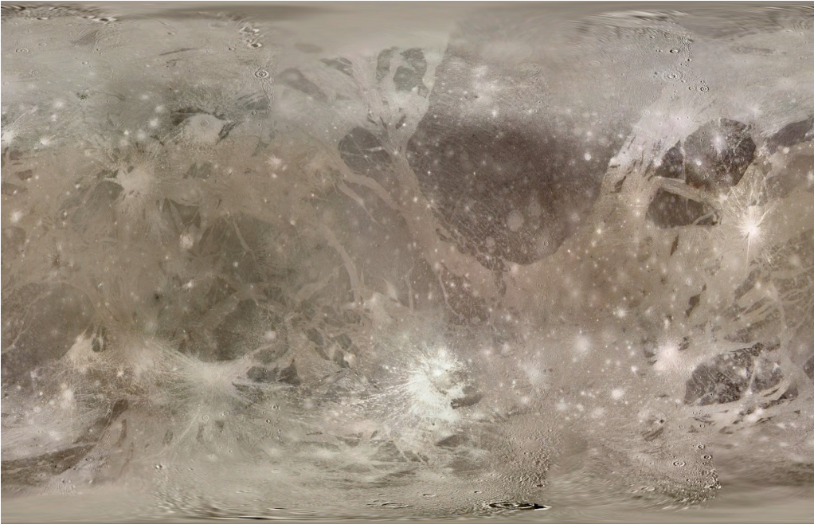
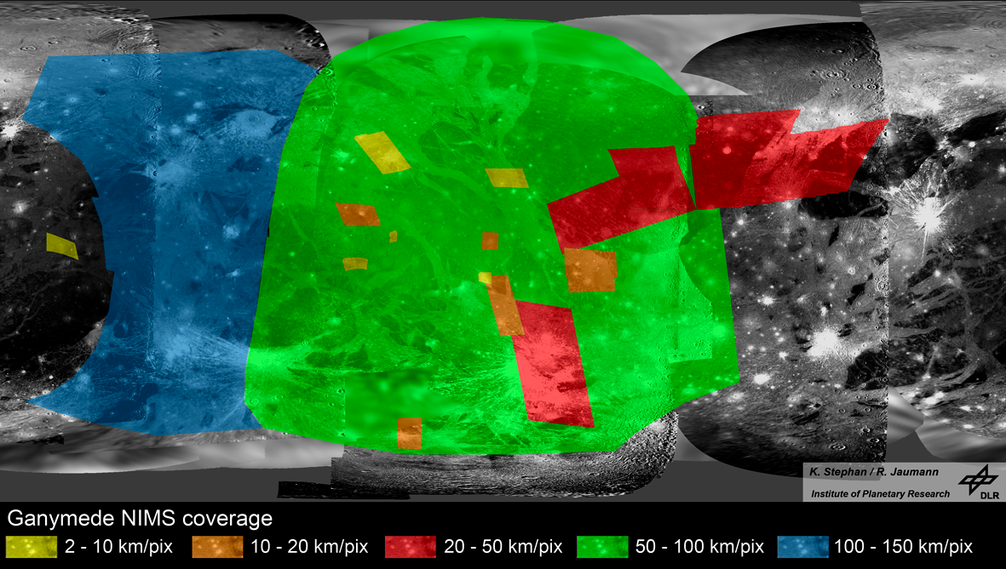
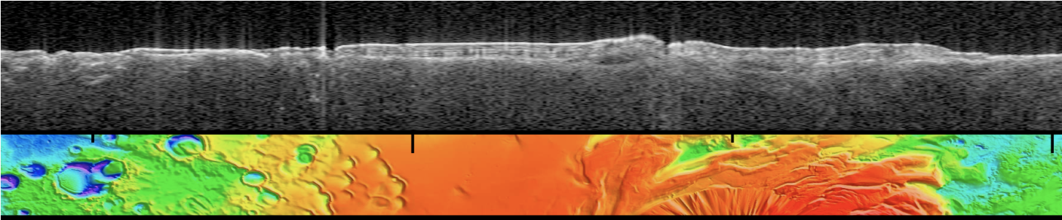
Essential elements
Characterise Ganymede as a planetary object and possible habitat
2. Composition, distribution, and evolution of surface materials
What are the surface chemical compounds ?
Exogeneous /endogeneous ?
Remote sensing
Spatial coverage
>50% at 2-3 km/px
100 m/px on a few %
10 m/px where needed
Spectral coverage
4 times better than Galileo NIMS
Close to lab data quality when needed
Volatiles
Ions and Neutrals
Galileo NIMS coverage
How does the surface relate to the subsurface ?
Instrument Packages
Spectroscometer
Imaging
In situ Neutral Particles
Radar sounder

Slide 17
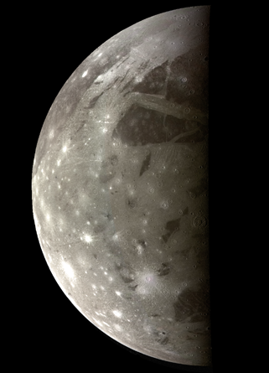
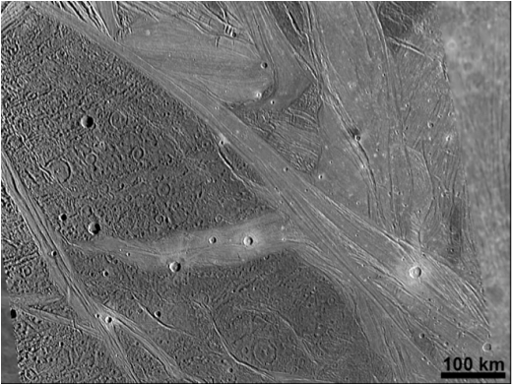
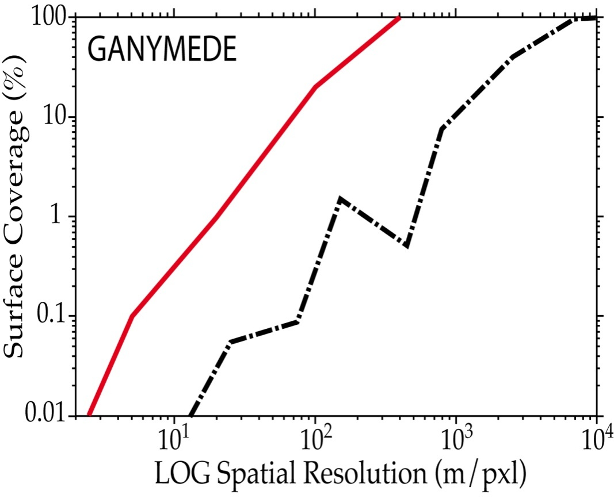
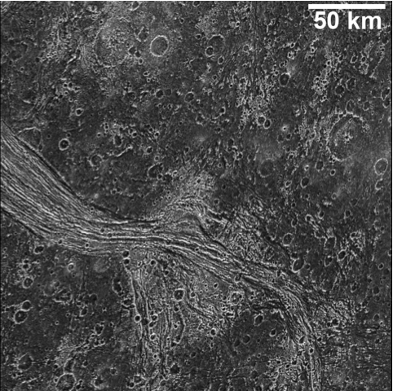
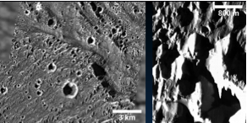
Stability - resonnance
Characterise Ganymede as a planetary object and possible habitat
3. Formation of surface features and search for past and present activity
Measurements
Global imaging at 200-400 m/px
High Resolution target areas
Topography/
morphology
Subsurface exploration
Compositional relationships
G
Ganymede surface mapping
x 50
Dark terrain: ancient surface; furrow tectonics
JUICE
Galileo
Instrument Packages
Imaging
Spectrometers
Sounders
Bright terrain: Rift-like tectonism, icy volcanism

Slide 18
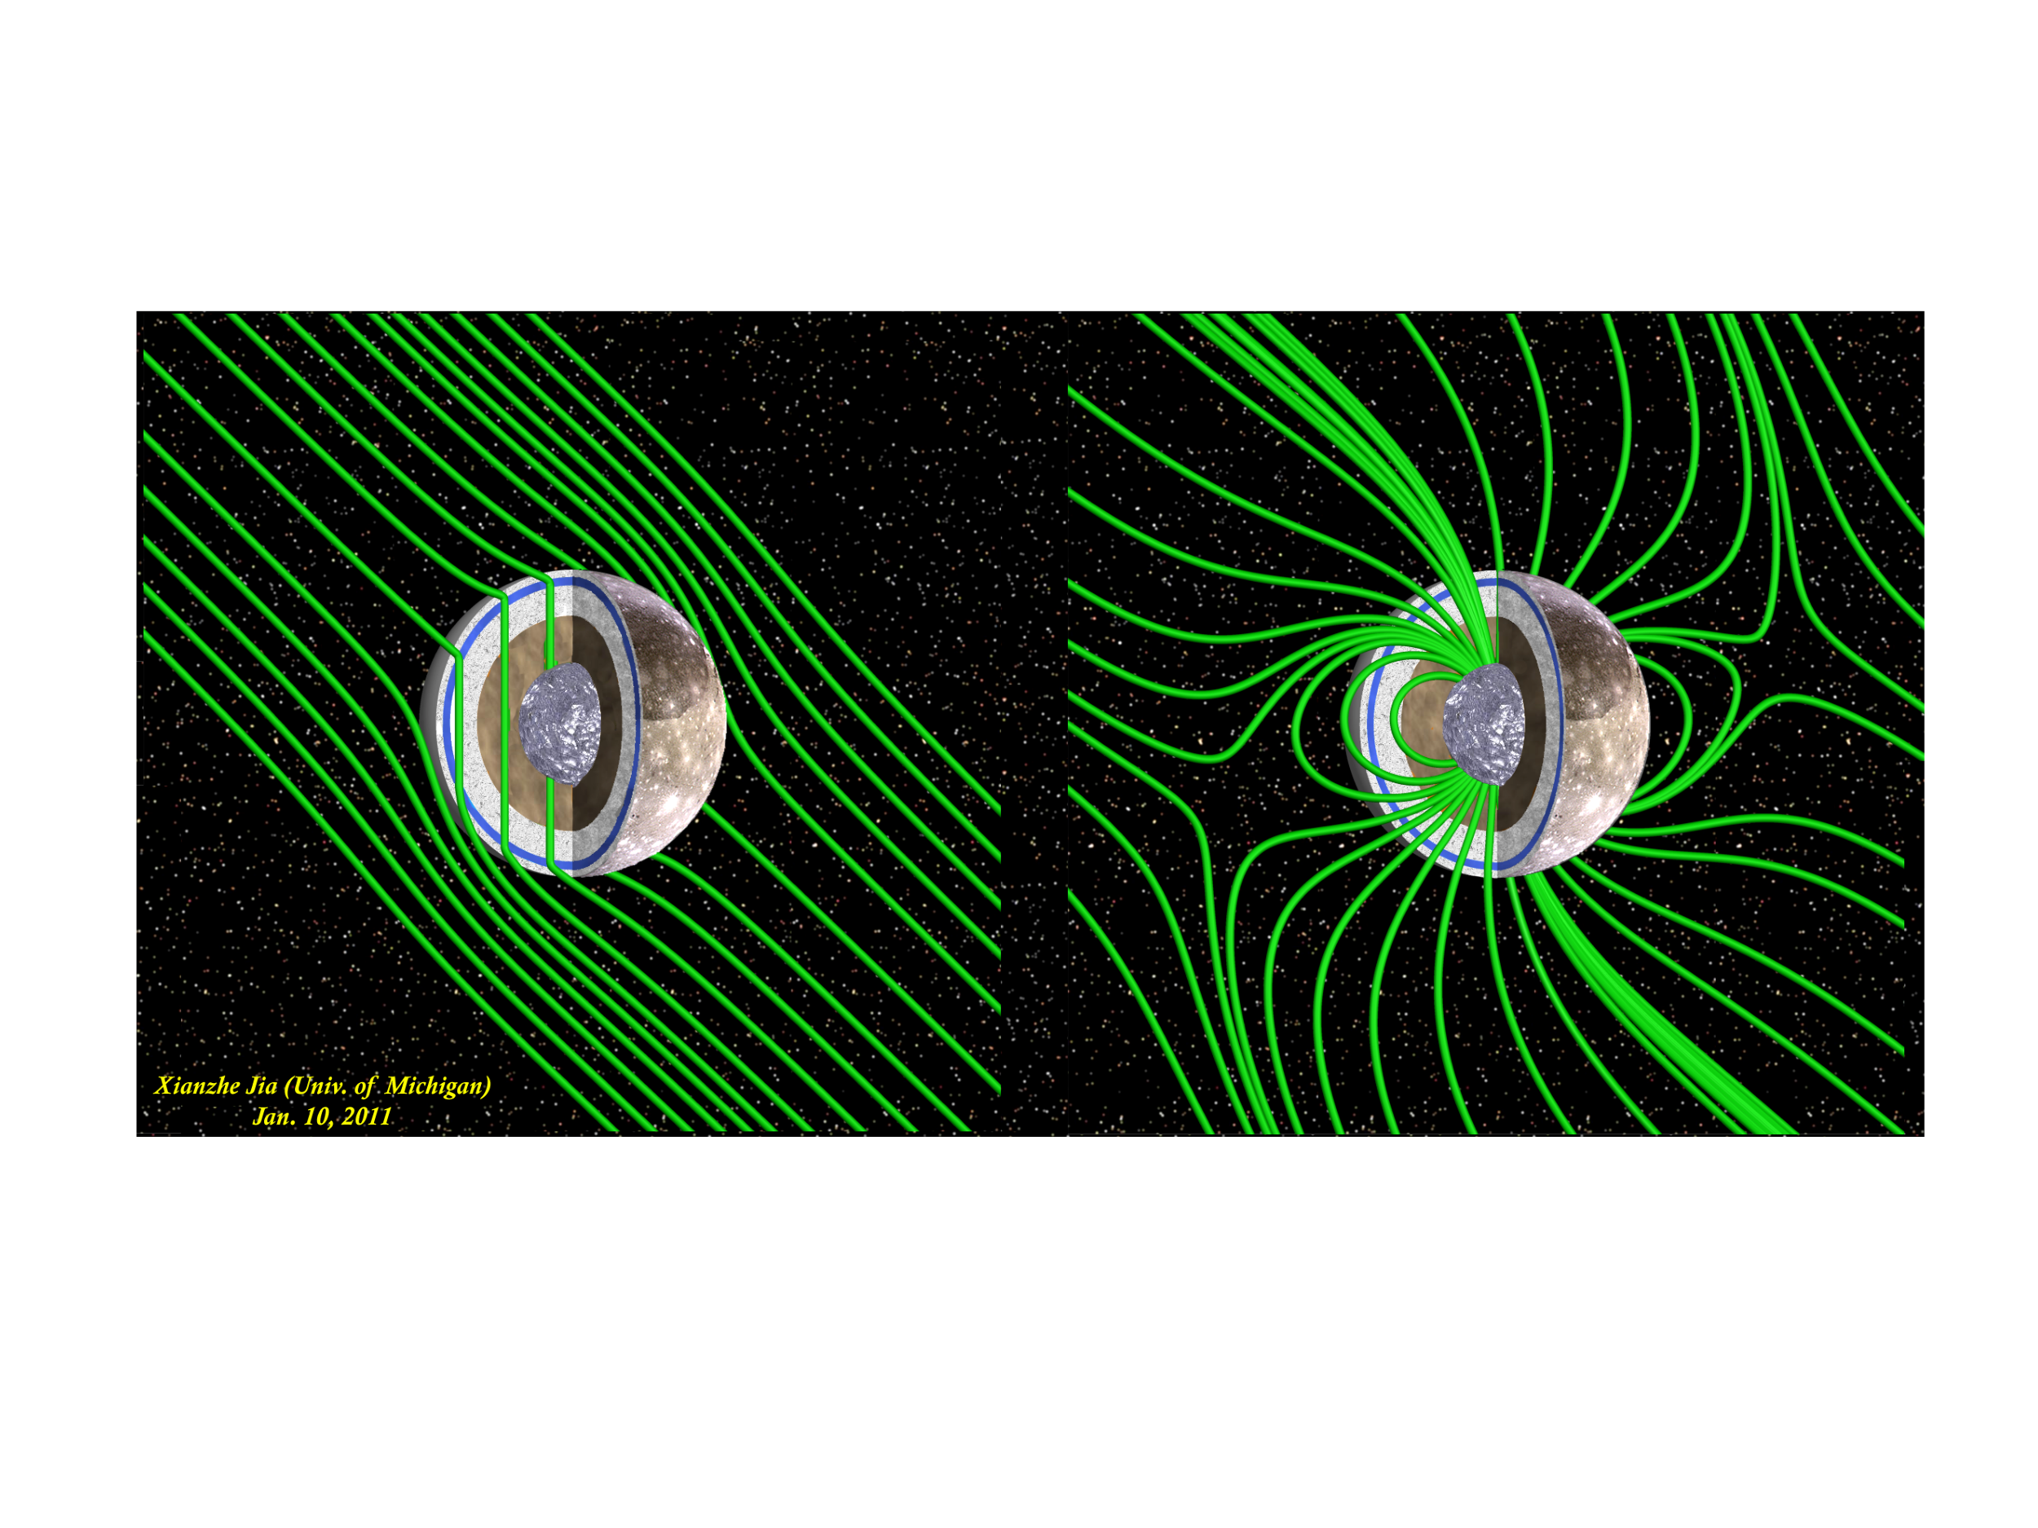
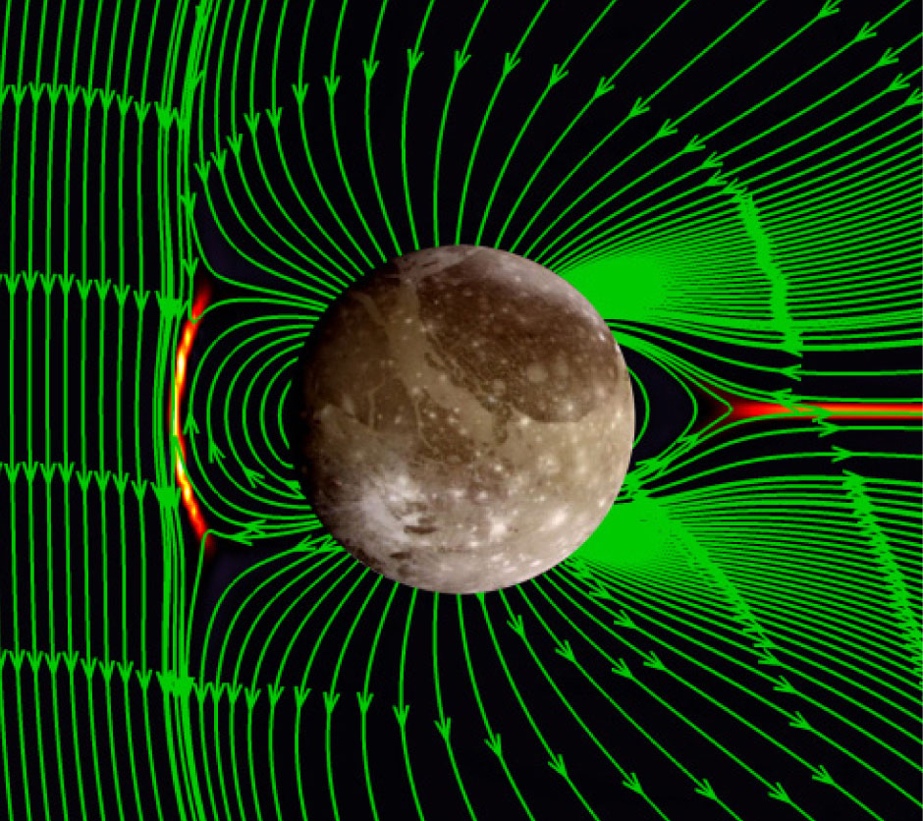
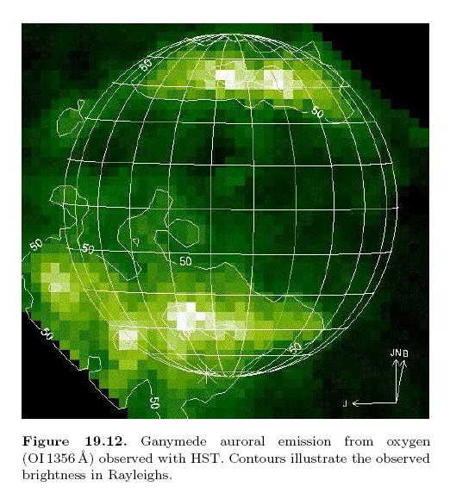
Characterise Ganymede as a planetary object and possible habitat
4. Characterise the local environment
Sources and sinks of atmosphere
Dipole magnetic field and mini-magnetosphere
Coupling to Jupiter’s magnetosphere
In situ Fields and Particles
Imaging
Spectroscopy
Radio science

Slide 19
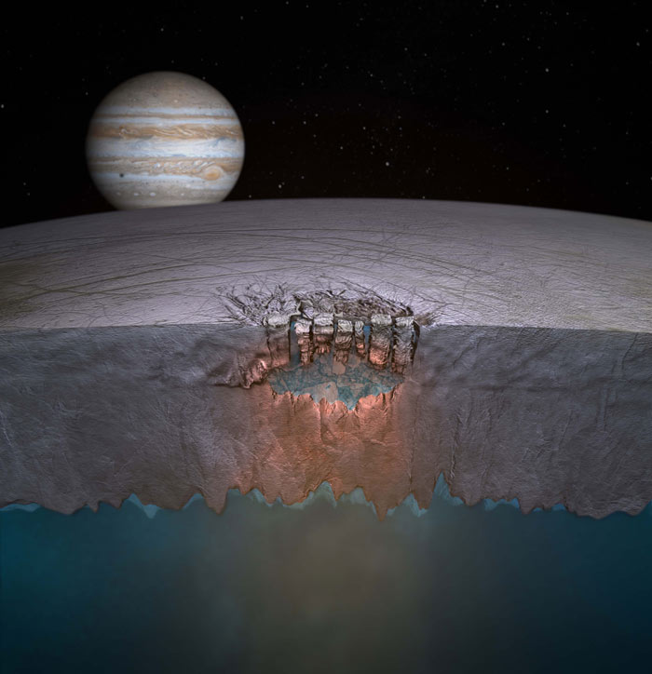
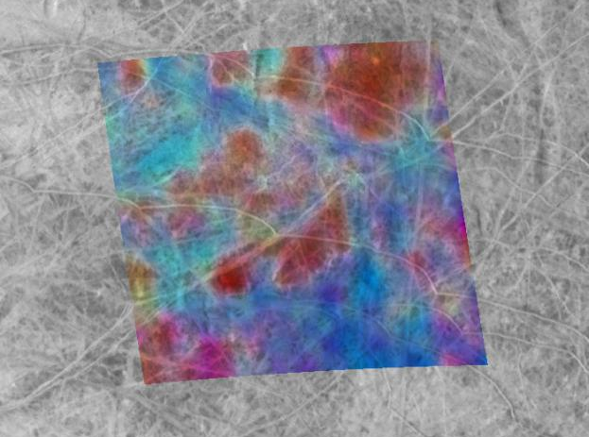
Liquid water
Exploration of the habitable zone
Explore Europa recently active zones
JUICE will tell us:
If liquid reservoirs exist
If the salinity is comparable to our oceans
How thick the crust is in chaos regions
If the moon is still active
Potentially where we could land in the future

Slide 20
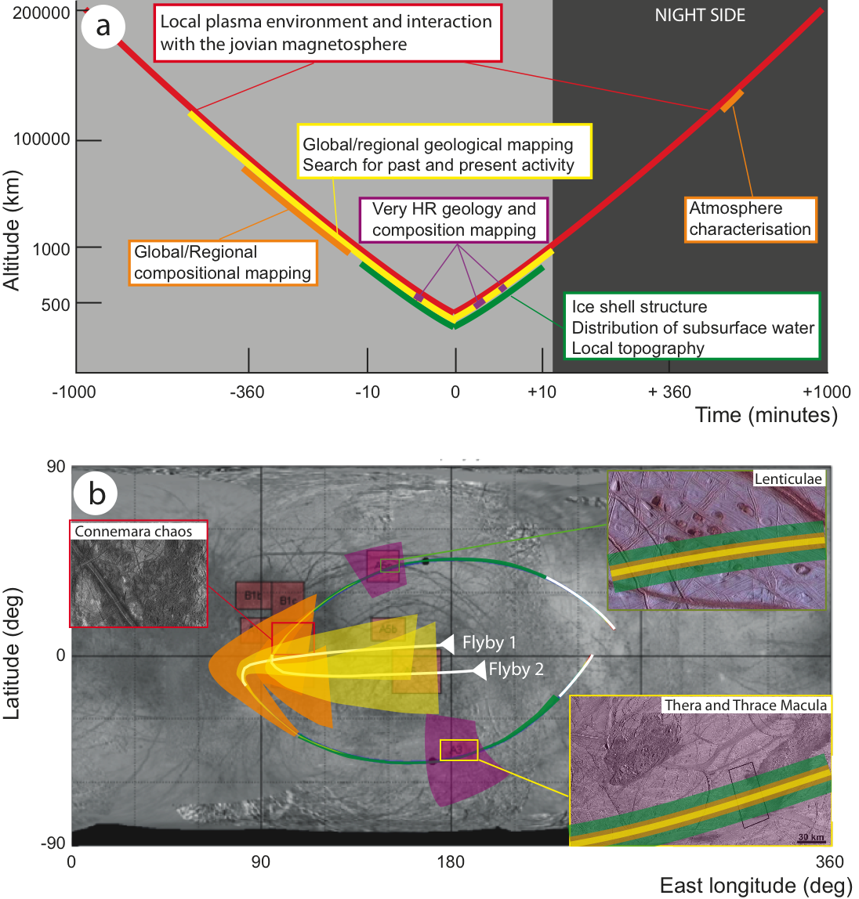
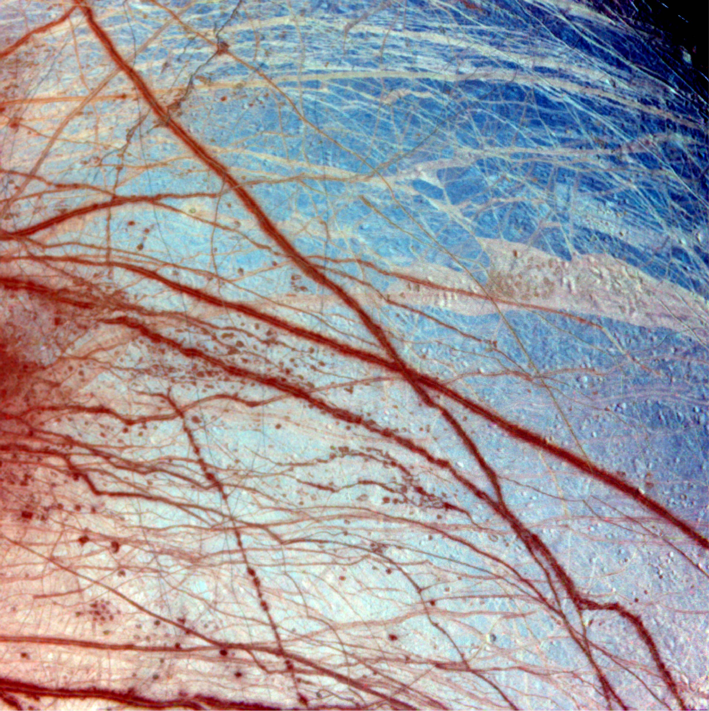
Explore Europa recently active zones
Flyby strategy:
In-situ observations
Imaging
Infrared observations
Ice penetrating radar
altimetry
Will result in :
Characterisation of induced field
Composition and geology of areas of high interest
First subsurface exploration of recently active regions

Slide 21
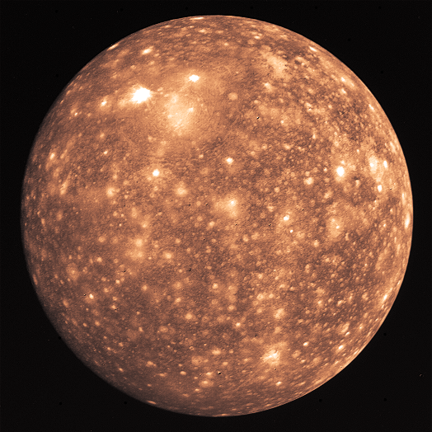
Liquid water
Exploration of the habitable zone
Study Callisto as a remnant of the early Jovian system
WHY CALLISTO?
SUMMARY
JUICE OBJECTIVES
Characterise the outer shells, including the ocean
Determine the composition of the non-water ice material
Study the past activity including the differentiation processes

Slide 22
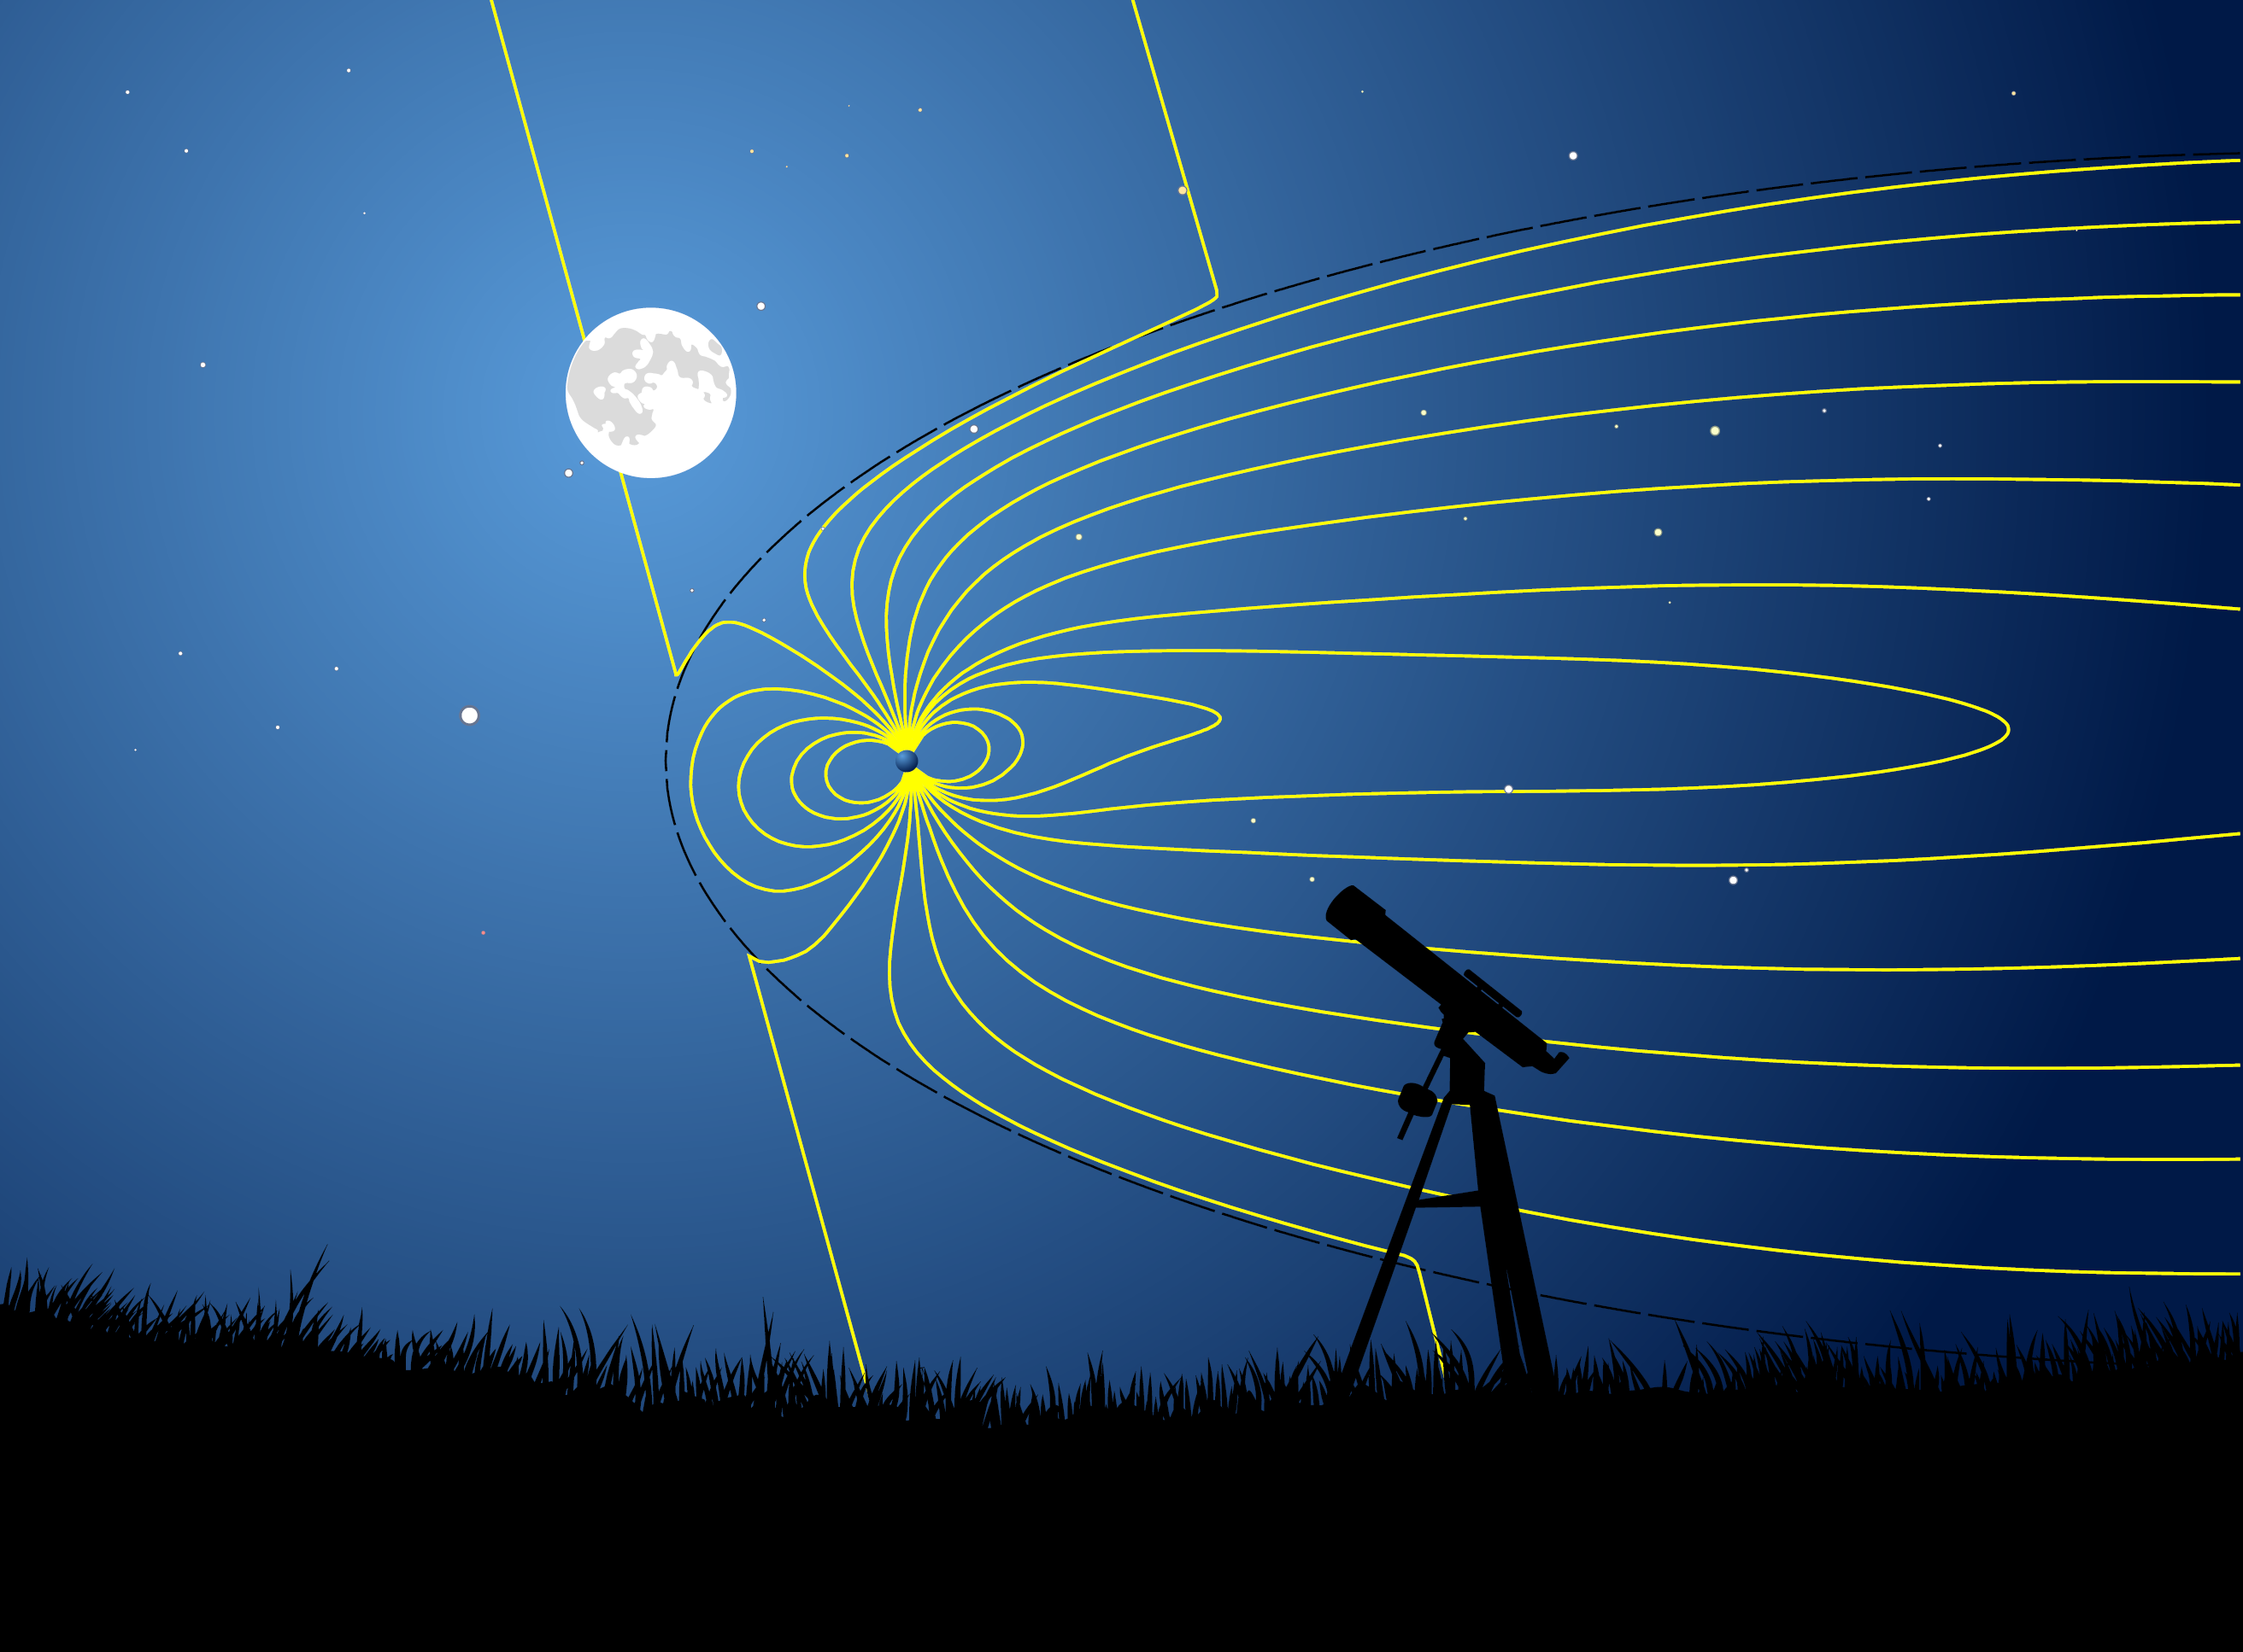

Liquid water
Explore the Jupiter system as an archetype for gas giants
Explore the Jovian magnetosphere
JUICE objectives
Study the dynamics of magnetosphere in and out of the magnetodisc
Determine the electrodynamic coupling between the planet and the satellites
Assess global and continuous acceleration of particles

Slide 23


Explore the Jovian magnetosphere
1 and 2. Study the dynamics and the coupling processes
Properties
Energy transfer in the coupled system
UV aurora – main oval and moon footprints
Io
Ganymede
Europa
Instrument Packages
In situ Fields and Particles
Imaging
Spectroscopy
Radio science

Slide 24

Explore the Jovian magnetosphere
3. Assess global and continuous acceleration of particles
Particle acceleration
Mass loss processes
Equatorial plane
600 R_{J}
900 R_{J}

Slide 25






Explore the Jupiter system as an archetype for gas giants
Characterise the Jovian atmosphere
JUICE OBJECTIVES
Characterise the atmospheric dynamics and circulation
Characterise the atmospheric composition and chemistry
Characterise the atmospheric vertical structure

Slide 26

Characterise the Jovian atmosphere
1. Study the exchange processes from deep abyssal interior to the external environment
How does Jupiter’s atmosphere couple to the immediate planetary environment?
What is the circulation in the middle atmosphere, and how is it coupled to the deeper atmosphere (e.g., waves?)
How is energy transported to and redistributed within the upper atmosphere?
What is the chemistry of the middle atmosphere, and the rate of exogenic influx of material?
How are albedo contrasts related to environmental conditions?
How are zonal winds, eddies and vortices powered in the weather layer?
What is the composition and properties of Jupiter’s clouds & hazes?
What is the importance of moist convection?
How does the atmosphere couple to the deep abyssal layer?

Slide 27

Characterise the Jovian atmosphere
2. Study the exchange processes at each depth from equatorial regions to the poles
Mid-latitudes
How stable are extra-tropical jets, and what powers the jets?
What is the origin of planetary waves at mid-latitudes?
Equatorial Zone & Belts
What controls tropical oscillation periods ?
What is the circulation and dynamics of equatorial upwelling, giant storms, plumes, vortices?
What determines the colour life cycle of Jupiter’s belts?
Polar latitudes
Apex of a planet-wide circulation, unique hazes, chemistry, temp.
Connection to aurorae and charged environment?

Slide 28




Jupiter Remote Sensing
Characterise the Jovian atmosphere
3. Evaluate the variability, on multiple timescales from hours to years, of the processes transporting energy, momentum and material from place to place.
Ultra-Violet (UVIS):
Stellar occultations, high-altitude hazes, chemistry, ionosphere/thermosphere
Near-IR (VIRHIS):
5-10 nm resolution; cloud studies; resolve NH3/H2O ice features; extend beyond 5 µm thermal emission
Sub-mm (SWI):
Middle atmosphere, stratospheric winds & waves, temperatures, H₂O and trace species
λ
Visible Camera (HRC/WAC):
Narrow filters to probe strong CH₄ absorptions, cloud structure, wind tracking, lightning studies, cloud colouration
Radio science (JRST-USO)
Temperature & density sounding; e- density profiles; tropospheric NH3, H2S, PH3 opacity at depth
Advanced instrumentation for global & regional observations with broad spectral coverage from UV to radio wavelengths

Slide 29
Firsts slide
JUICE
Conclusions
Internat. Interest
The Firsts
Cosmic Vision
Impact
Timeliness
Orbiter of an icy moon
European led mission to outer solar system
Subsurface exploration of icy moons
Opportunity to characterise the waterworlds class of planetary bodies
Opportunity to completely explore Ganymede’s unique combination of magnetic fields
Prolonged study of mid-high latitudes of Jupiter’s magnetosphere
Direct measurements of atmospheric circulation in Jupiter’s middle atmosphere

